Slide 1
Data Link Control (DLC)
CS44 Data Communication and Networking

Slide 2
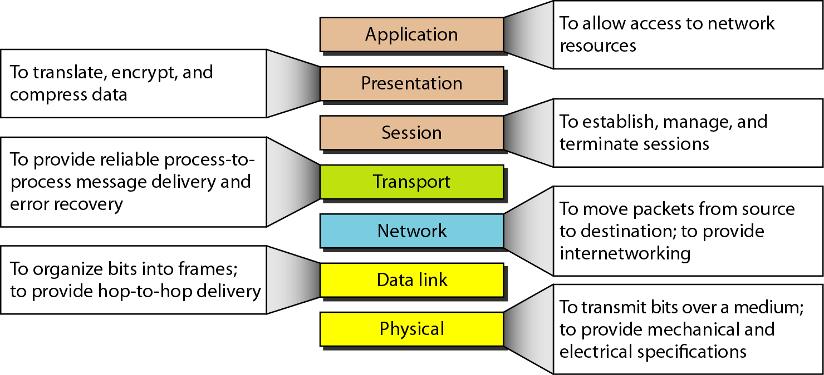
Summary of Layers

Slide 3
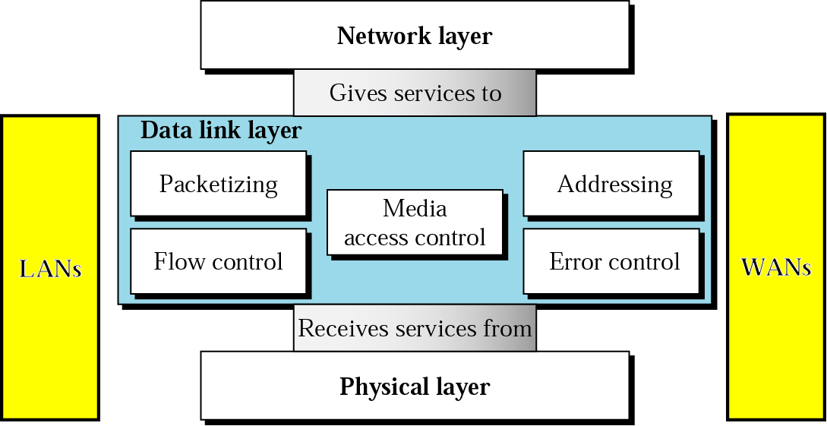
Data Link Layer - functions

Slide 4
Data Link Layer Functions
The data-link layer is divided into two sublayers
Data link control (DLC)
Deals with the design and procedures for communication between two adjacent nodes: node-to-node communication
DLC functions include
Framing
flow and error control
Media access control (MAC)
Dealswith how to share the link
To implement data link control, we need protocols that provide smooth and reliable transmission of frames between nodes
a set of rules that need to be implemented in software and run by the two nodes involved in data exchange at the data link layer
Notes:
The most important responsibilities of the data link layer are flow control and error control. these functions are known as :
data link control.

Slide 5
Framing
Framing in the data-link layer separates a message from one source to a destination by adding a sender address and a destination address
The destination address defines where the packet is to go
The sender address helps the recipient acknowledge the receipt
Why the whole message not packed in one frame?
A frame can be very large, making flow and error control very inefficient
When a message is carried in one very large frame, even a single-bit error would require the retransmission of the whole frame
When a message is divided into smaller frames, a single-bit error affects only that small frame
Frame Size?
Fixed-Size Framing
Variable-Size Framing

Slide 6
Framing …
Fixed-Size Framing
no need for defining the boundaries of the frames
the size itself can be used as a delimiter
An example of this type of framing is the ATM WAN, which uses frames of fixed size called cells
ATM: Asynchronous Transfer Mode( connection oriented, high-speed network technology that is used in both LAN and WAN over optical fiber and operates upto gigabit speed )
Variable-Size Framing -
need a way to define the end of one frame and the beginning of the next
Historically, two approaches were used for this purpose:
a character-oriented (or byte-oriented) approach
a bit-oriented approach
prevalent in local-area networks

Slide 7
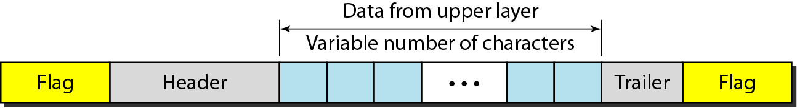
Character-Oriented Framing
Data to be carried are 8-bit characters from a coding system such as ASCII
The header (also multiples of 8 bits) normally carries
the source and destination addresses
other control information
the trailer, which carries error detection redundant bits
To separate one frame from the next, an 8-bit (1-byte) flag is added at the beginning and the end of a frame
The flag composed of protocol-dependent special characters

Slide 8
Problem with flag
Text communication: flag could be selected to be any character not used for text communication
Sending other types of information such as graphs, audio, and video: any character used for the flag could also be part of the information
If flag is a part of the information, the receiver, when it encounters this pattern in the middle of the data, thinks it has reached the end of the frame

Slide 9
Solution to Flag Problem
Add a byte-stuffing strategy to character-oriented framing
In byte stuffing (or character stuffing), a special byte is added to the data section of the frame when there is a character with the same pattern as the flag
The data section is stuffed with an extra byte
called the escape character (ESC) and has a predefined bit pattern
Whenever the receiver encounters the ESC character, it removes it from the data section and treats the next character as data, not as a delimiting flag
If the escape character is part of the text, an extra one is added to show that the second one is part of the text

Slide 10
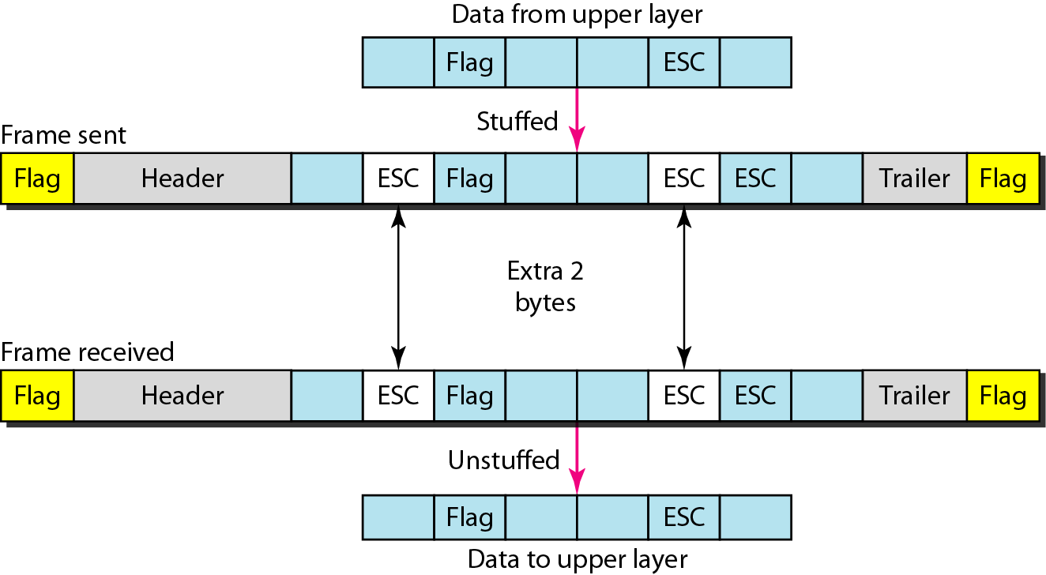
Byte stuffing and unstuffing
The universal coding systems in use today, such as Unicode, have 16-bit and 32-bit characters that conflict with 8-bit characters
bit-oriented protocols

Slide 11
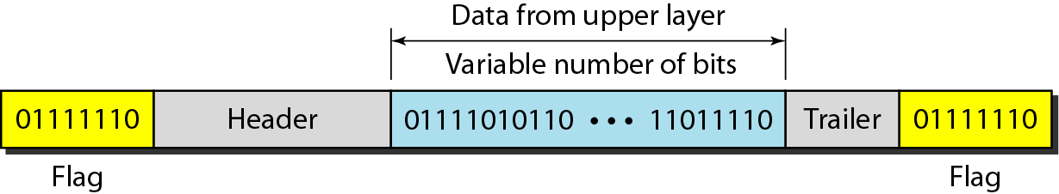
Bit-Oriented Framing
Data section of a frame is a sequence of bits to be interpreted by the upper layer as text, graphic, audio, video, and so on
In addition to headers (and possible trailers), need a delimiter to separate one frame from the other
Most protocols use a special 8-bit pattern flag, 01111110, as the delimiter to define the beginning and the end of the frame

Slide 12
Bit-Oriented Framing
Bit stuffing is the process of adding one extra 0 whenever five consecutive 1s follow a 0 in the data, so that the receiver does not mistake the pattern 0111110 for a flag
If the flaglike pattern 01111110 appears in the data, it will change to 011111010 (stuffed) and is not mistaken for a flag by the receiver
The real flag 01111110 is not stuffed by the sender and is recognized by the receiver

Slide 13
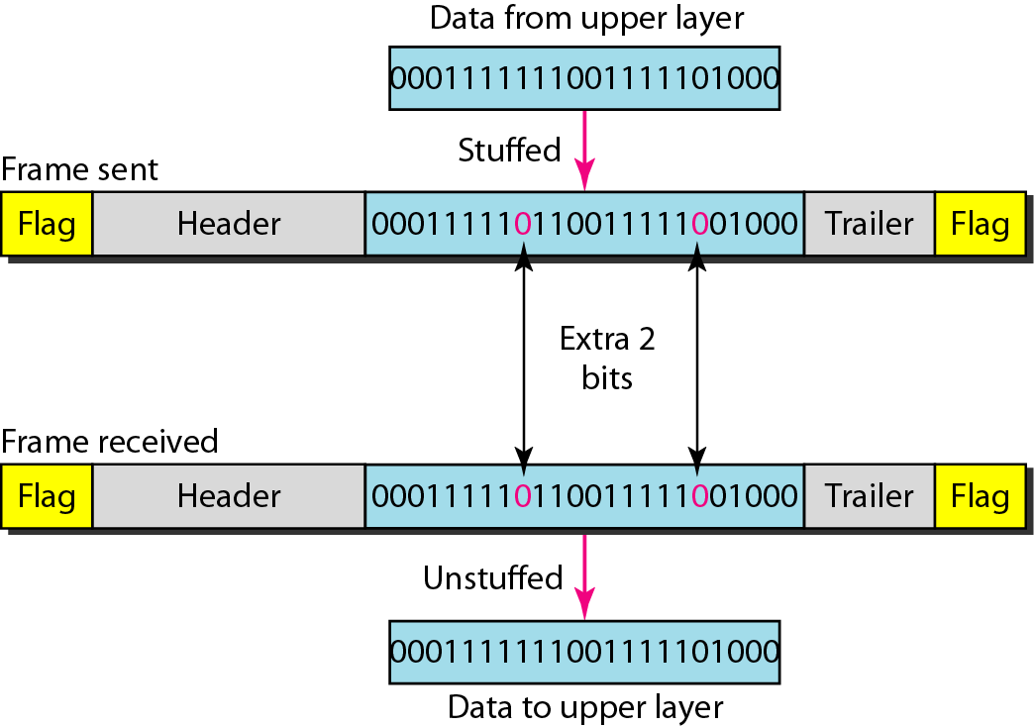
Bit-Oriented Framing

Slide 14
Example 1
Byte-stuff the following frame payload in which
E is the escape byte
F is the flag byte
D is a data byte
other than an escape or a flag character.
F D E E D D E F D D E E E E D E F D F

Slide 15
Example 2
Unstuff the following frame payload in which
E is the escape byte
F is the flag byte
D is a data byte
other than an escape or a flag character.
E D F D D F E D D D

Slide 16
Example 3
Bit-stuff the following frame payload:
0001111111001111101000111111111110000111
00011111011001111100100011111011111010000111

Slide 17
Example 4
Unstuff the following frame payload:
00011111000001111101110100111011111000001111
00011111000001111101110100111011111000001111
00011111000011111111010011101111100001111

Slide 18
Programming Examples
Write and test a program that simulates the byte stuffing and byte unstuffing
Write and test a program that simulates the bit stuffing and bit unstuffing

Slide 19
Error Control
At the data-link layer, corrupted frame needs to be corrected before it continues its journey to other nodes
Detecting errors
block coding
cyclic codes – CRC
checksums
Correcting errors
Forward error correction
Hamming distance
XORing of packets
interleaving chunks
compounding high and low resolutions packets
Automatic repeat request (ARQ)
Most link-layer protocols simply discard the frame and let the upper-layer protocols handle the retransmission of the frame

Slide 20
Error Detection and Correction Issues
Types of Errors
Single-bit and burst error
Redundancy
some extra bits with our data
Detection versus Correction
Coding
block coding and convolution coding

Slide 21
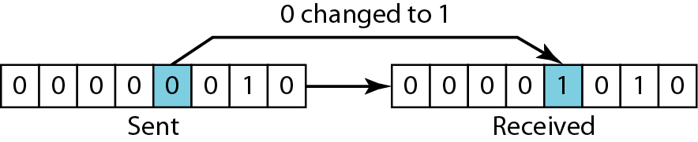
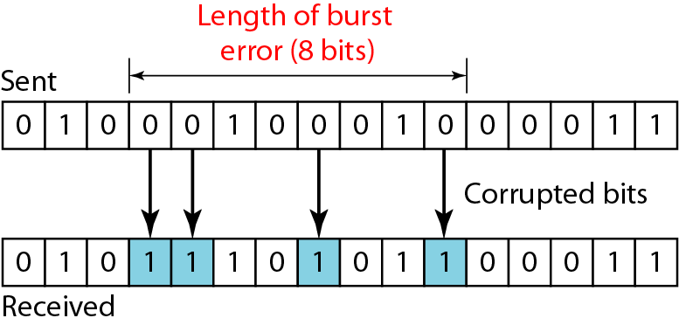
Types of Errors
Single-bit errors: only 1 bit of a given data unit is changed from 1 to 0 or from 0 to 1
Burst errors: 2 or more bits in the data unit is changed from 1 to 0 or from 0 to 1
more likely to occur because the duration of the noise signal is normally longer than the duration of 1 bit
The number of bits affected depends on the data rate and duration of noise
Consider a noise of 1/100 second, 1 kbps data rate can affect 10 bits whereas 1 Mbps data rate affect 10,000 bits
Notes:
Whenever bits flow from one point to another, they are subject to unpredictable changes because of interference. This interference can change the shape of the signal.
The term single-bit error means that only 1 bit of a given data unit (such as a byte, character, or packet) is changed from 1 to 0 or from 0 to 1. The term burst error means that 2 or more bits in the data unit have changed from 1 to 0 or from 0 to 1. Figure 10.1
shows the effect of a single-bit and a burst error on a data unit.
A burst error is more likely to occur than a single-bit error because the duration of the noise signal is normally longer than the duration of 1 bit, which means that when noise affects data, it affects a set of bits. The number of bits affected depends on the data rate and duration of noise. For example, if we are sending data at 1 kbps, a noise of 1/100 second can affect 10 bits; if we are sending data at 1 Mbps, the same noise can affect 10,000 bits.

Slide 22
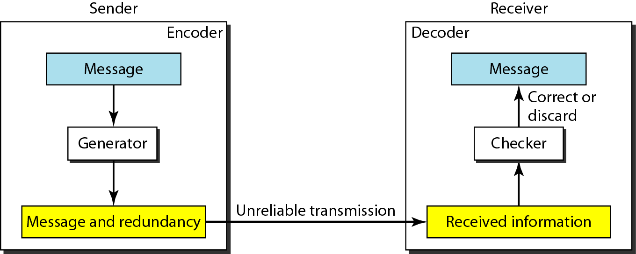
Redundancy
To detect or correct errors, redundant bits (some extra bits) of data must be added by sender and removed by receiver
allows the receiver to detect or correct corrupted bits
Notes:
To be able to detect or correct errors, we need to send some extra bits with our data. These redundant
bits are added by the sender and removed by the receiver. Their presence allows the receiver to detect or correct corrupted bits.

Slide 23
Coding
The process of adding redundancy for error detection or correction creates a relationship between the redundant bits and the actual data bits
Two types:
Block codes
Divides the data to be sent into a set of blocks
Extra information attached to each block
Memoryless
Convolutional codes
Treats data as a series of bits, and computes a code over a continuous series
The code computed for a set of bits depends on the current and previous input
Notes:
Redundancy is achieved through various coding schemes. The sender adds redundant bits through a. The receiver checks the relationships between the two sets of bits to detect errors. The ratio of redundant bits to data bits and the robustness of the process are important factors in any coding scheme.
We can divide coding schemes into two broad categories: block coding and convolution coding. In this book, we concentrate on block coding; convolution coding is more complex and beyond the scope of this book.

Slide 24
Detection versus Correction
correction of errors is more difficult than the detection
error detection → only looking to see if any error has occurred not the number of corrupted bits
No difference between a single-bit error and a burst error
error correction→ need to know the exact number of bits that are corrupted with their location in the message
8-bit data unit
to correct a single error → need to consider eight possible error locations
to correct two errors → need to consider 2^8 (permutation of 8 by 2) possible error locations
Receiver find difficulty to correct 10 errors in a data unit of 1000 bits
Notes:
The. In. The answer is a simple yes or no. We are not even interested in the number of corrupted bits. A single-bit error is the same for us as a
burst error. In
and, more importantly,. The number of errors and the size of the message are important factors. If we need in an 8-bit
data unit, we; if we need to correct two errors in a data unit of the same size, we need to consider 28 (permutation of 8 by 2) possibilities. You can imagine the receiver’s difficulty in finding 10 errors in a data unit of 1000 bits.

Slide 25
Notes
An error-detecting/correcting code can detect/correct only the types of errors for which it is designed
Other types of errors may remain undetected.
There is no way to detect/correct every possible error!

Slide 26
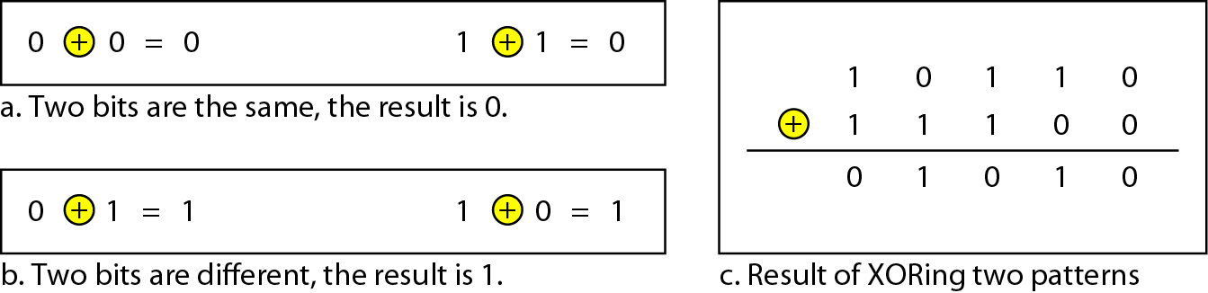
XOR Operation
Main operation for computing error detection/correction codes
Simpler and faster than addition; no carry bit!
Similar to modulo-2 addition

Slide 27
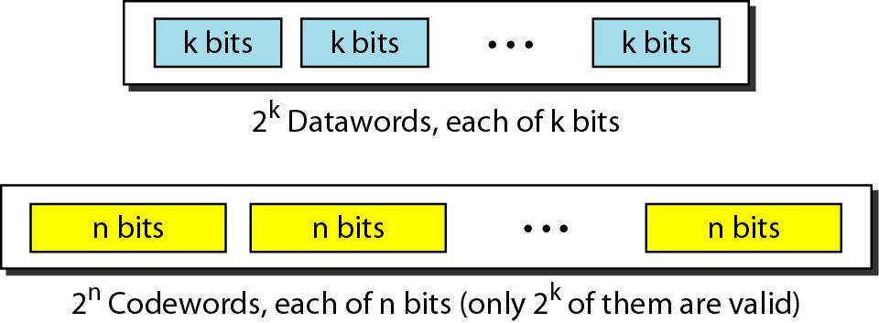
Block Coding
Message is divided into k-bit blocks
Known as datawords
r redundant bits are added
Blocks become n=k+r bits
Known as codewords
2^{n} − 2^{k} codewords that are not used
invalid or illegal
If the receiver receives an invalid codeword, this indicates that the data was corrupted during transmission.
Notes:
2n − 2k codewords that are not used. We call these codewords invalid or illegal. The trick in
error detection is the existence of these invalid codes, as we discuss next. If the receiver receives an invalid codeword, this indicates that the data was corrupted during transmission.

Slide 28
How can errors be detected by using block coding?
Two conditions the receiver follows to detect a change in the original codeword
1. The receiver has (or can find) a list of valid codewords
2. The original codeword has changed to an invalid one

Slide 29
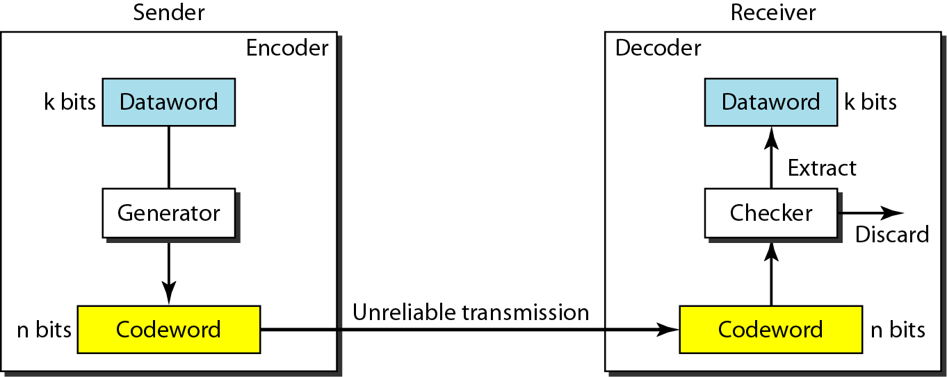
Error Detection in Block Coding
if the codeword is corrupted during transmission but the received word still matches a valid codeword, the error remains undetected.
Notes:
The sender creates codewords out of datawords by using a generator that applies the rules and procedures of encoding (discussed later). Each codeword sent to the receiver may change during transmission. If the received codeword is the same as one of the valid codewords, the word is accepted; the corresponding dataword is extracted for use. If the received codeword is not valid, it is discarded. However, if the codeword is corrupted during transmission but the received word still matches a valid codeword, the error remains undetected.

Slide 30

Error-detecting Code Example
Let us assume that k = 2 and n = 3
The list of datawords and codewords
sender encodes the dataword 01 as 011 and sends it to the receiver
receiver receives 011→ a valid codeword → extracts 01 dataword
receiver receives 111 →not a valid codeword → discarded
receiver receives 000→ a valid codeword → incorrectly extracts 00 dataword → Two corrupted bits have made the error undetectable
Notes:
Assume the sender encodes the dataword 01 as 011 and sends it to the receiver. Consider the
following cases:
1. The. The receiver from it.
2. The codeword is corrupted during transmission, and (the leftmost bit is corrupted).
This is.
3. The codeword is corrupted during transmission, and 000 is received (the right two bits are
corrupted). This is a valid codeword. The receiver incorrectly extracts the dataword 00. Two corrupted bits have made the error undetectable.

Slide 31
Hamming Distance
Hamming Distance between two words is the number of differences between corresponding bits.
Hamming distance between the received codeword and the sent codeword is the number of bits that are corrupted during transmission → important for error detection
if the Hamming distance between the sent and the received codeword is not zero, the codeword has been corrupted during transmission
Found by XOR operation (⊕) on the two words and count the number of 1s in the result
d(000, 011) is 2 because (000 ⊕ 011) is 011 (two 1s)
d(10101, 11110) is 3 because (10101 ⊕ 11110) is 01011 (three 1s)
Notes:
One of the central concepts in coding for error control is the idea of the Hamming distance.
The Hamming distance between two words (of the same size) is the number of
differences between the corresponding bits. We show the Hamming distance between two
words x and y as d(x, y). We may wonder why Hamming distance is important for error detection. The reason is that the Hamming distance between the received codeword and the sent codeword is the number of bits that are corrupted during transmission. For example,
if the codeword 00000 is sent and 01101 is received, 3 bits are in error and the Hamming
distance between the two is d(00000, 01101) = 3. In other words, if the Hamming distance between the sent and the received codeword is not zero, the codeword has been corrupted during transmission.
The Hamming distance can easily be found if we apply the XOR operation (⊕). Note that the Hamming distance is a value greater than or equal to zero.

Slide 32
Minimum Hamming Distance
The minimum Hamming distance is the smallest Hamming distance between all possible pairs in a set of codewords.
Find the minimum Hamming Distance of the following codebook
00000
01011
10101
11110
minimum Hamming Distance = 3
Notes:
In a set of codewords, the minimum Hamming distance is the smallest Hamming distance between all possible pairs of codewords. Now let us find the minimum Hamming distance in a code if we want to be able to detect up to s errors. If s errors occur during transmission, the Hamming distance between the sent codeword and received codeword is s. If our system is to detect up to s errors, the minimum distance between the valid codes must be (s + 1), so that the received codeword does not match a valid codeword. In other words, if the minimum distance between all valid codewords is (s + 1), the received codeword cannot be erroneously mistaken for another codeword. The error will be detected. We need to clarify a point here: Although a code with dmin = s + 1 may be able to detect more than s errors in some special cases, only s or fewer errors are guaranteed to be detected.

Slide 33
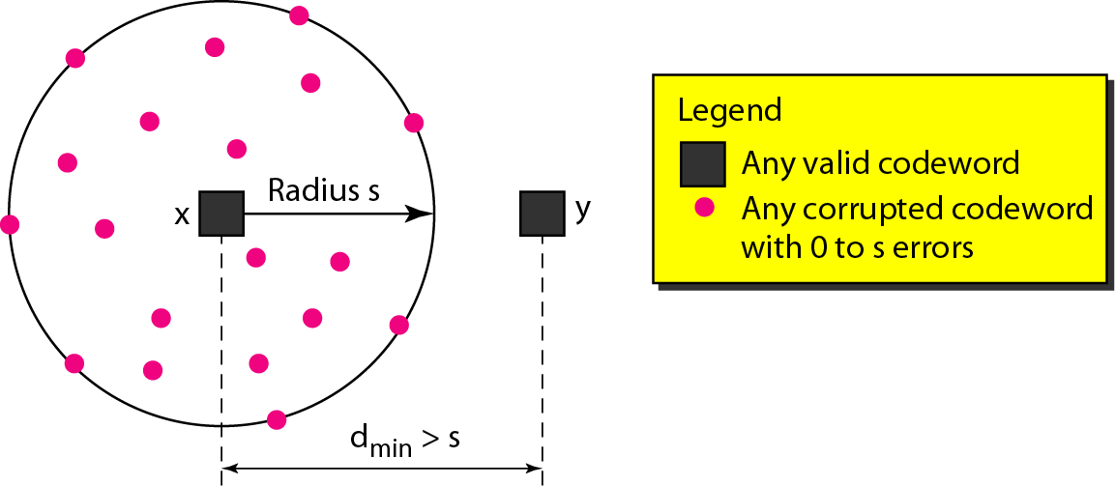
Detection Capability of Code
To guarantee the detection of up to s-bit errors, the minimum Hamming distance in a block code must be
d_{min} = s + 1
A code scheme with Hamming distance d_{min} = 4 guarantees the detection of up to three errors (d = s + 1 or s = 3)

Slide 34
Error-detecting Code Example
Let us assume that k = 2 and n = 3. The list of datawords and codewords
The minimum Hamming distance =2
guarantees detection of only a single error
If the codeword 101 is sent and one error occurs, the received codeword does not match any valid codeword
If two errors occur, however, the received codeword may match a valid codeword and the errors are not detected
First codeword | 000 | 000 | 000 | 011 | 011 | 101
Second codeword | 011 | 101 | 110 | 101 | 110 | 110
result | 011 | 101 | 110 | 110 | 101 | 011
Hamming distance | 2 | 2 | 2 | 2 | 2 | 2
Notes:
The minimum Hamming distance for our first code scheme (Table 10.1) is 2. This code guarantees detection of only a single error. For example, if the third codeword (101) is sent and one error occurs, the received codeword does not match any valid codeword. If two errors occur,
however, the received codeword may match a valid codeword and the errors are not detected.

Slide 35
Linear Block Codes
Two types
linear block codes – today's choice
requires the knowledge of abstract algebra (particularly Galois fields)
a code in which the exclusive OR (addition modulo-2) of two valid codewords creates another valid codeword
nonlinear block codes - not as widespread because their structure makes theoretical analysis and implementation difficult
This code in Table is a linear block code because the result of XORing any codeword with any other codeword is a valid codeword
First codeword | 000 | 000 | 000 | 011 | 011 | 101
Second codeword | 011 | 101 | 110 | 101 | 110 | 110
result | 011 | 101 | 110 | 110 | 101 | 011
Valid/invalid | V | V | V | V | V | V
Notes:
Almost all block codes used today belong to a subset of block codes called linear block
codes. The use of nonlinear block codes for error detection and correction is not as
widespread because their structure makes theoretical analysis and implementation difficult.
We therefore concentrate on linear block codes. The formal definition of linear
block codes requires the knowledge of abstract algebra (particularly Galois fields),
which is beyond the scope of this book. We therefore give an informal definition. For
our purposes, a linear block code is a code in which the exclusive OR (addition
modulo-2) of two valid codewords creates another valid codeword.
The code in Table 10.1 is a linear block code because the result of XORing any codeword with any other codeword is a valid codeword. For example, the XORing of the second and third codewords creates the fourth one.

Slide 36
Minimum Distance for Linear Block Codes
the number of 1s in the nonzero valid codeword with the smallest number of 1s
So the minimum Hamming distance is d_{min} = 2.
First codeword | 000 | 000 | 000 | 011 | 011 | 101
Second codeword | 011 | 101 | 110 | 101 | 110 | 110
result | 011 | 101 | 110 | 110 | 101 | 011
Hamming distance | 2 | 2 | 2 | 2 | 2 | 2

Slide 37
Common Detection Methods
Parity check
Cyclic Redundancy Check
Checksum

Slide 38
Parity Check
Most common linear block code, least complex
Single bit (called the parity bit) is added to a block
a k-bit dataword is changed to an n-bit codeword where n = k + 1
Two schemes:
Even parity – Maintain even number of 1s
Extra bit used to make the total number of 1s in the codeword even
E.g., 1011 → 10111
Odd parity – Maintain odd number of 1s
Extra bit used to make the total number of 1s in the codeword odd
E.g., 1011 → 10110
Minimum Hamming distance is d_{min} = 2
means that the code is a single-bit error-detecting code
Notes:
Perhaps the most familiar error-detecting code is the parity-check code. This code is
. In this code,. The extra bit,, is selected to. Although some implementations specify an odd
number of 1s, we discuss the even case.
The minimum Hamming distance for this category is dmin = 2, which. Our
first code (Table 10.1) is a parity-check code (k = 2 and n = 3). The code in Table 10.2
is also a parity-check code with k = 4 and n = 5.

Slide 39
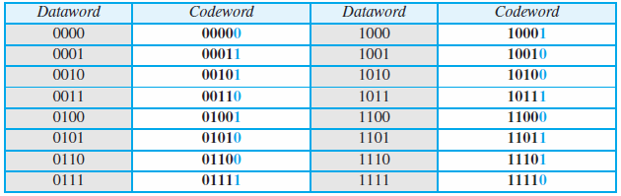
Parity Check Examples
A parity-check code k = 2 and n = 3
A parity-check code with k = 4 and n = 5
Dataword | codeword
00 | 000
01 | 011
10 | 101
11 | 110

Slide 40
Example: Parity Check
Suppose the sender wants to send the word world. In ASCII the five characters are coded (with even parity) as
1110111 1101111 1110010 1101100 1100100
The following shows the actual bits sent
11101110 11011110 11100100 11011000 11001001
Receiver receives this sequence of words:
11111110 11011110 11101100 11011000 11001001
Which blocks are accepted? Which are rejected?
11111110 11011110 11101100 11011000 11001001
R A R A A

Slide 41
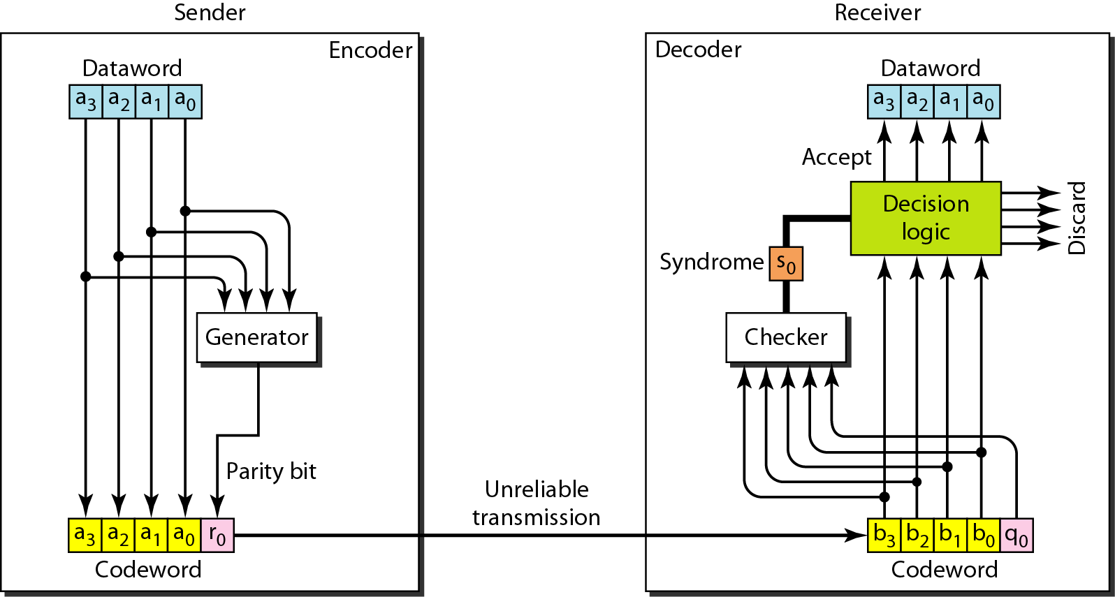
Parity-Check: Encoding/Decoding
r0 = a3 + a2 +a1 +a0 (modulo-2)
s0 = b3 + b2 +b1 +b0+q0 (modulo-2)
Rule to make total number of 1s in the codeword is even: If the number of 1s is even, r0=0 else r0=1
Rule of the decision logic analyzer : If s0=0, no detectable error in the received codeword (accept) else detectable error (discard)
Notes:
The calculation is done in modular arithmetic (see Appendix E). The encoder uses a generator that takes a copy of a 4-bit dataword (a0, a1, a2, and a3) and generates a parity bit r0. The dataword bits and the parity bit create the 5-bit codeword. The parity bit that is added makes the number of 1s in the codeword even. This is normally done by adding the 4 bits of the dataword (modulo-2); the result is the parity bit.
The sender sends the codeword, which may be corrupted during transmission. The receiver receives a 5-bit word. The checker at the receiver does the same thing as the generator in the sender with one exception: The addition is done over all 5 bits. The result, which is called the syndrome, is just 1 bit. The syndrome is 0 when the number of 1s in the received codeword is even; otherwise, it is 1. The syndrome is passed to the decision logic analyzer. If the syndrome is 0, there is no detectable error in the received codeword; the data portion of the received codeword is accepted as the dataword; if the syndrome is 1, the data portion of the received codeword is discarded. The dataword is not created.

Slide 42
Cyclic Codes
Special linear block codes
In a cyclic code, rotating a codeword always results in another codeword
n the rightmost equation, the last bit of the first word is wrapped around and becomes the first bit of the second word
Example: Consider the bits in the first word a0 to a6, and the bits in the second word b0 to b6, we can shift the bits by using the following
b1 = a0
b2 = a1
b3 = a2
b4 = a3
b5 = a4
b6 = a5
b0 = a6
Cyclic codes → correct errors
1011000 is a codeword → cyclically left-shift
Result is 0110001 → also a codeword
Notes:
are with one extra property. In a cyclic code, if a codeword is cyclically shifted (rotated), the result is another codeword. For example, if 1011000 is a codeword and we cyclically left-shift, then 0110001 is also a codeword. In this case, if we call the bits in the first word a0 to a6, and the bits in the second word b0 to b6, we can shift the bits by using the following:
create. However, the theoretical background required is beyond the scope of this book.

Slide 43
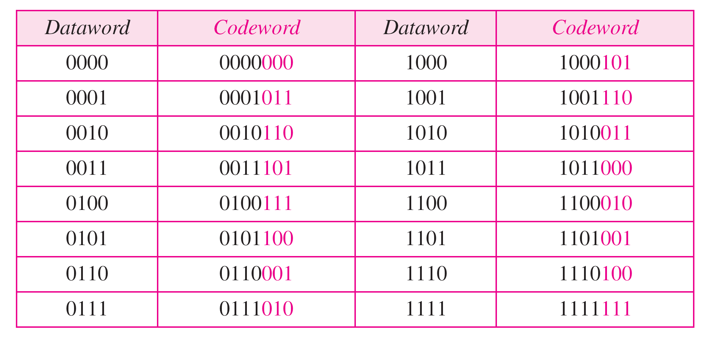
Cyclic Redundancy Check (CRC)
A subset of cyclic codes
Has both the linear and cyclic properties
Used in networks such as LANs and WANs
A CRC code with C(7, 4)

Slide 44
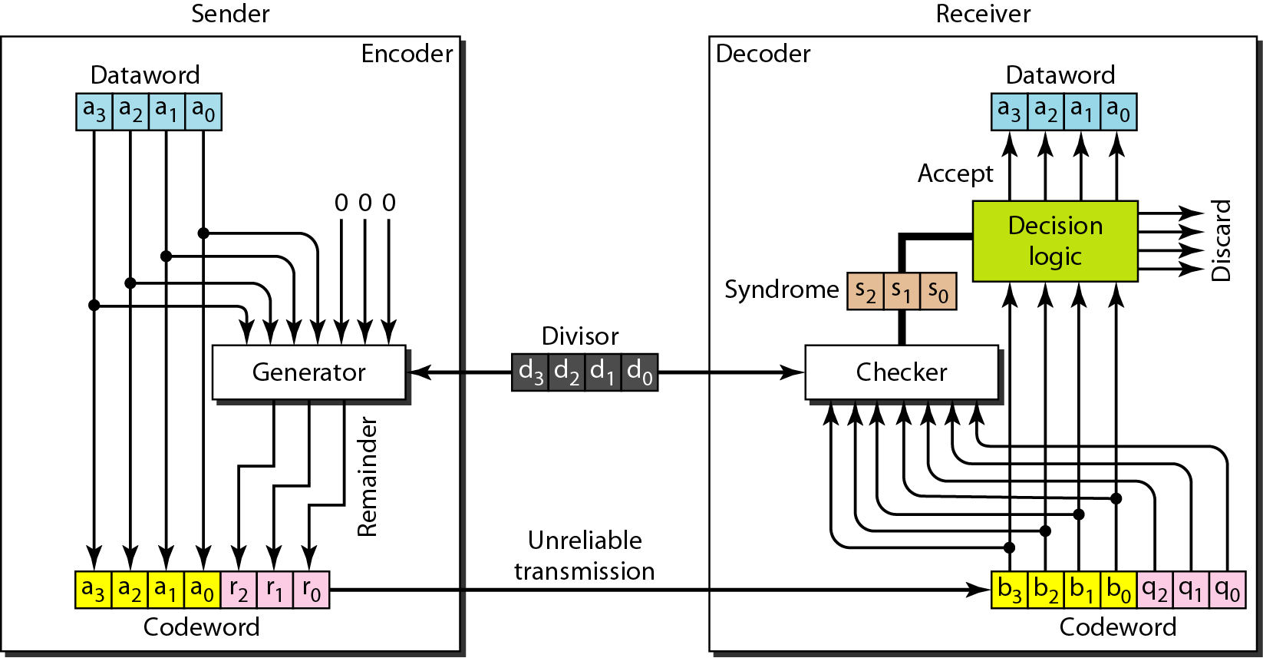
CRC Encoder/Decoder
If the syndrome bits are all 0s, the 4 leftmost bits of the codeword are accepted as the dataword (interpreted as no error); otherwise, the 4 bits are discarded (error).
One possible design:
k bits (4 here)
Added n − k (3 here) 0s to the right-hand side
(modulo-2 division)
divisor of size n − k + 1 (4 here), predefined and agreed upon
remainder produced by checker
Quotient is discarded; remainder (r2r1r0) is appended to dataword to create codeword
copy of all n bits is fed to the checker
n bits (7 here)
Notes:
In the encoder, the dataword has k bits (4 here); the codeword has n bits (7 here). The size of the dataword is augmented by adding n − k (3 here) 0s to the right-hand side of the word. The n-bit result is fed into the generator. The generator uses a divisor of size n − k + 1 (4 here), predefined and agreed upon. The generator divides the augmented dataword by the divisor (modulo-2 division). The quotient of the division is discarded; the remainder (r2r1r0) is appended to the dataword to create the codeword.
The decoder receives the codeword (possibly corrupted in transition). A copy of all n bits is fed to the checker, which is a replica of the generator. The remainder produced by the checker is a syndrome of n − k (3 here) bits, which is fed to the decision logic analyzer. The analyzer has a simple function. If the syndrome bits are all 0s, the 4 leftmost bits of the codeword are accepted as the dataword (interpreted as no error); otherwise, the 4 bits are discarded (error).

Slide 45
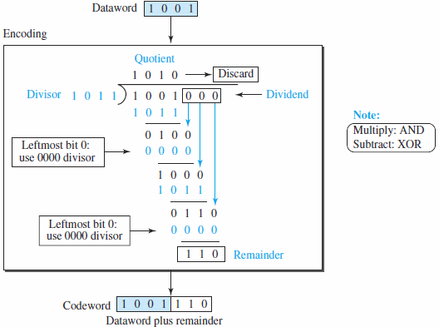
CRC Generator
Division in CRC encoder:
Modulo-2 binary division
Addition and subtraction are the same → use XOR operation to do both
copy of the dEach step: a divisor is XORed with the 4 bits of the dividend
Result (remainder) is 3 bits (in this case), which is used for the next step after 1 extra bit is pulled down to make it 4 bits long
Note: If the leftmost bit of the dividend (or the part used in each step) is 0, the step cannot use the regular divisor; we need to use an all-0s divisor
When there are no bits left to pull down, we have a result
3-bit remainder forms the check bits (r2, r1, and r0). They are appended to the dataword to create the codeword
How the divisor 1011 is chosen?
Depends on the expectation we have from the code- we will discuss this in polynomials.
Notes:
The process of modulo-2 binary division is the same as the familiar division process we use for decimal numbers. However, addition and subtraction in this case are the same; we use the XOR operation to do both. As in decimal division, the process is done step by step. In each step, a copy of the divisor is XORed with the 4 bits of the dividend. The result of the XOR operation (remainder) is 3 bits (in this case), which is used for the next step after 1 extra bit is pulled down to make it 4 bits long. There is one important point we need to remember in this type of division. If the leftmost bit of the dividend (or the part used in each step) is 0, the step cannot use the regular divisor; we need to use an all-0s divisor.
When there are no bits left to pull down, we have a result. The 3-bit remainder forms the check bits (r2, r1, and r0). They are appended to the dataword to create the codeword.
Divisor: We may be wondering how the divisor 1011 is chosen. This depends on the expectation we have from the code. We will show some standard divisors later in the chapter (Table 10.4) after we discuss polynomials.

Slide 46
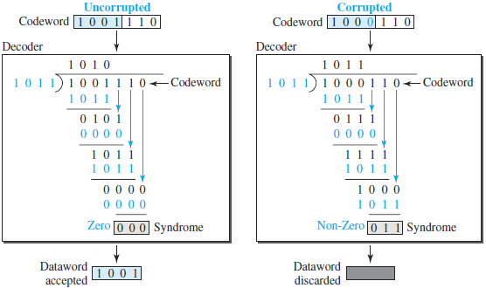
Checking CRC
Division in the CRC decoder for two cases: division process as the encoder
no error
a single error
Remainder of the division is the syndrome
Notes:
The codeword can change during transmission. The decoder does the same division process as the encoder. The remainder of the division is the syndrome. If the syndrome is all 0s, there is no error with a high probability; the dataword is separated from the received codeword and accepted. Otherwise, everything is discarded. Figure 10.7 shows two cases: The left-hand figure shows the value of the syndrome when no error has occurred; the syndrome is 000. The right-hand part of the figure shows the case in which there is a single error. The syndrome is not all 0s (it is 011).

Slide 47
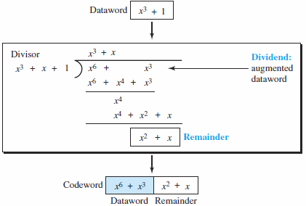
Cyclic Code Encoder Using Polynomials
Creation of a codeword from a dataword
Binary Division in CRC encoder | CRC division using polynomials
Process is shorter
Dataword 1001 is represented as x³ + 1
Divisor 1011 is represented as x³ + x + 1
Augmented dataword is x⁶ + x³ → we have left-shifted the dataword 3 bits (multiplying by x³⁾
Continue to divide until the degree of the remainder is less than the degree of the divisor
In a polynomial representation, the divisor is normally referred to as the generator polynomial
The divisor in a cyclic code is normally called the generator polynomial or simply the generator
Notes:
The result is x6 + x3. Division is straightforward. We divide the first term of the dividend, x6, by the first term of the divisor, x3. The first term
of the quotient is then x6/x3, or x3. Then we multiply x3 by the divisor and subtract (according to our previous definition of subtraction) the result from the dividend. The result is x4, with a degree greater than the divisor’s degree; we continue to divide until the degree of the remainder is less than the degree of the divisor.
It can be seen that the polynomial representation can easily simplify the operation of division in this case, because the two steps involving all-0s divisors are not needed here. (Of course, one could argue that the all-0s divisor step can also be eliminated in binary division.) In a polynomial representation, the divisor is normally referred to as the generator polynomial t(x).

Slide 48
Checksum
An error-detecting technique that can be applied to a message of any length
In the Internet, the checksum technique is mostly used at the network and transport layer rather than the data-link layer
At the source
Message is first divided into m-bit units
The generator then creates an extra m-bit unit called the checksum, which is sent with the message
At the destination
the checker creates a new checksum from the combination of the message and sent checksum
If the new checksum is all 0s, the message is accepted; otherwise, the message is discarded
Note: in the real implementation, the checksum unit is not necessarily added at the end of the message; it can be inserted in the middle of the message

Slide 49
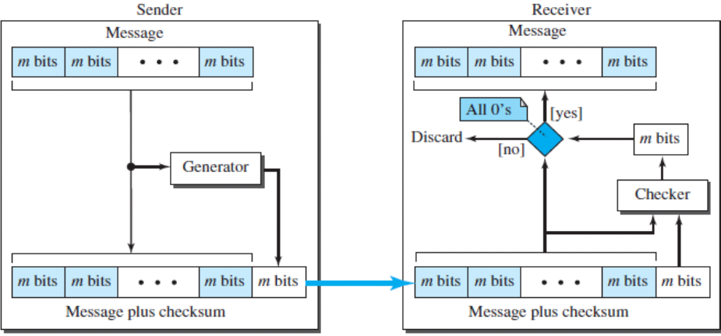
Checksum ...

Slide 50
Checksum - simple example
Suppose the message is a list of five 4-bit numbers that we want to send to a destination. In addition to sending these numbers, we send the sum of the numbers.
For example, if the set of numbers is (7, 11, 12, 0, 6), we send (7, 11, 12, 0, 6, 36), where 36 is the sum of the original numbers.
The receiver adds the five numbers and compares the result with the sum
If the two are the same, the receiver assumes no error, accepts the five numbers, and discards the sum
Otherwise, there is an error somewhere and the message is not accepted.

Slide 51
Checksum - example
Drawback - Each number can be written as a 4-bit word (each is less than 15) except for the sum
One solution is to use one’s complement arithmetic
In this arithmetic, we can represent unsigned numbers between 0 and 2^{m} − 1 using only m bits
If the number has more than m bits, the extra leftmost bits need to be added to the m rightmost bits (wra

Slide 52
One’s complement arithmetic
Complement of a number → completing all bits (changing all 1s to 0s and all 0s to 1s)
same as subtracting the number from 2^{m} − 1
Two 0s: one positive and one negative, which are complements of each other
The positive zero has all m bits set to 0
The negative zero has all bits set to 1 → it is 2^{m} − 1
If we add a number with its complement, we get a negative zero (a number with all bits set to 1)

Slide 53
Checksum - example
The decimal number 36 in binary is 100100
To change it to a 4-bit number - we add the extra leftmost bit to the right four bits
10
0100
(10)₂ + (0100)₂ = (0110)₂ → (6)₁₀
Instead of sending 36 as the sum, send 6 as the sum (7, 11, 12, 0, 6, 6)
Notes:
(10)₂ + (0100)₂ = (0110)₂ → (6)₁₀
Instead of sending 36 as the sum, we can send 6 as the sum (7, 11, 12, 0, 6, 6)
The receiver can add the first five numbers in one’s complement arithmetic
If the result is 6, the numbers are accepted; otherwise, they are rejected

Slide 54
Checksum - example
The receiver can add the first five numbers in one’s complement arithmetic
If the result is 6, the numbers are accepted; otherwise, they are rejected
1111
+ 0110
10
0100
10101
1111
+0000
Number | Binary
7 | 0111
11 | 1011
12 | 1100
0 | 0000
6 | 0110
1111
0110
0111
+1011
0011
+1100
Result
10010
1111
0011

Slide 55
Checksum - example
How to make the receiver job easy?
Send the complement of the sum→ checksum
Eg. The sender adds all five numbers in one’s complement to get the sum = 6
The sender then complements the result to get the checksum = 9, which is 15 − 6.
The sender sends the five data numbers and the checksum (7, 11, 12, 0, 6, 9)

Slide 56
Checksum - example
If there is no corruption in transmission, the receiver receives (7, 11, 12, 0, 6, 9) and adds them in one’s complement to get 15
When the receiver adds all five numbers (including the checksum), if it gets a negative zero, the message is accepted; otherwise, it is rejected
Result of first five numbers
1111
+ 0110
0110
+ 1001
10101
1111
negative zero
complement
Add 9
0110
Positive zero

Slide 57
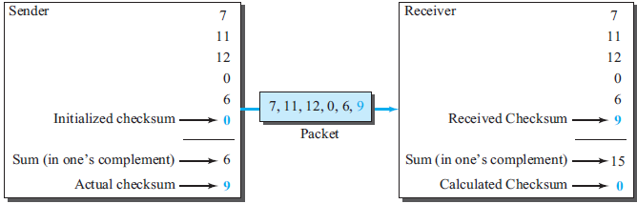
Checksum - example

Slide 58
Point-to-Point Protocol
Today, millions of Internet users who need to connect their home computers to the server of an Internet service provider use most common protocols for point-to-point access Point-to-Point Protocol (PPP)
The majority of these users have a traditional modem connected to the Internet through a telephone line, which provides the services of the physical layer
But to control and manage the transfer of data, there is a need for a point-to-point protocol at the data-link layer
PPP is a byte-oriented protocol

Slide 59
PPP Services
Services Provided by PPP
Format of the frame to be exchanged between devices
How two devices can negotiate the establishment of the link and the exchange of data
Accept payloads from several network layers (not only IP)
Optional authentication
The new version of PPP, called Multilink PPP, provides connections over multiple links
Network address configuration
useful when a home user needs a temporary network address to connect to the Internet

Slide 60
PPP Services
Services Not Provided by PPP
No flow control - A sender can send several frames one after another with no concern about overwhelming the receiver
A very simple mechanism for error control - A CRC field is used to detect errors
If the frame is corrupted, it is silently discarded; the upper-layer protocol needs to take care of the problem
Lack of error control and sequence numbering may cause a packet to be received out of order
No a sophisticated addressing mechanism to handle frames in a multipoint configuration

Slide 61

PPP frame format
a character-oriented (or byte-oriented) frame
starts and ends with a 1-byte flag with the bit pattern 01111110
defines what is being carried in the data field: either user data or other information
frame check sequence (FCS) is simply a 2-byte or 4-byte standard CRC
a constant value and set to 11111111 (broadcast address)
constant value 00000011 (imitating unnumbered frames in HDLC)
carries either the user data or other information (byte-stuffed with escape byte as 01111101) - maximum of 1500 bytes; but this can be changed during negotiation
Notes:
Payload field. This field carries either the user data or other information that we
will discuss shortly. The data field is a sequence of bytes with the default of a
maximum of 1500 bytes; but this can be changed during negotiation. The data field
is byte-stuffed if the flag byte pattern appears in this field. Because there is no field
defining the size of the data field, padding is needed if the size is less than the maximum
default value or the maximum negotiated value.

Slide 62
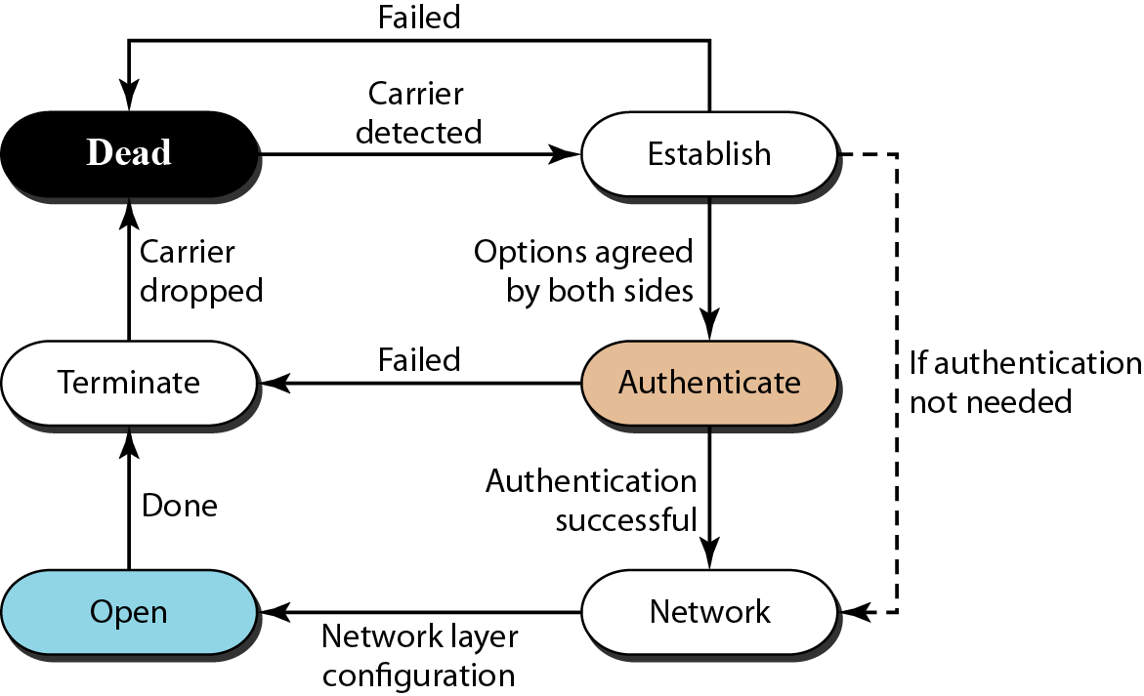
Transition Phases (FSM)
Notes:
In
this state, there is no active carrier (at the physical layer) and the line is quiet. When one
of the two nodes starts the communication, the connection goes into the establish state. In
this state, options are negotiated between the two parties. If the two parties agree that they
need authentication (for example, if they do not know each other), then the system needs
to do authentication (an extra step); otherwise, the parties can simply start communication.
The link-control protocol packets, discussed shortly, are used for this purpose. Several
packets may be exchanged here. Data transfer takes place in the open state. When a
connection reaches this state, the exchange of data packets can be started. The connection
remains in this state until one of the endpoints wants to terminate the connection. In this
case, the system goes to the terminate state. The system remains in this state until the carrier
(physical-layer signal) is dropped, which moves the system to the dead state again.

Slide 63
Transition Phases (FSM) …
Starts with the dead state- no active carrier (at the physical layer) and the line is quiet
When one of the two nodes starts the communication, the connection goes into the establish state
Negotiate options between the two parties through several packets exchange
Eg. If the two parties agree that they need authentication then the system needs to do authentication (an extra step); otherwise, the parties can simply start communication.
Data transfer takes place in the open state
The connection remains in this state until one of the endpoints wants to terminate the connection
System goes to the terminate state when one of the endpoints wants to terminate the connection
The system remains in this state until the carrier (physical-layer signal) is dropped, which moves the system to the dead state again

Slide 64
Multiplexing in PPP
Powerful PPP at a link-layer uses another set of protocols to
establish the link →Link Control Protocol (LCP)
authenticate the parties involved → two Authentication Protocols (APs)
carry the network-layer data → several Network Control Protocols (NCPs)
PPP packet can carry data from one of these protocols in its data field
Data may also come from several different network layers

Slide 65
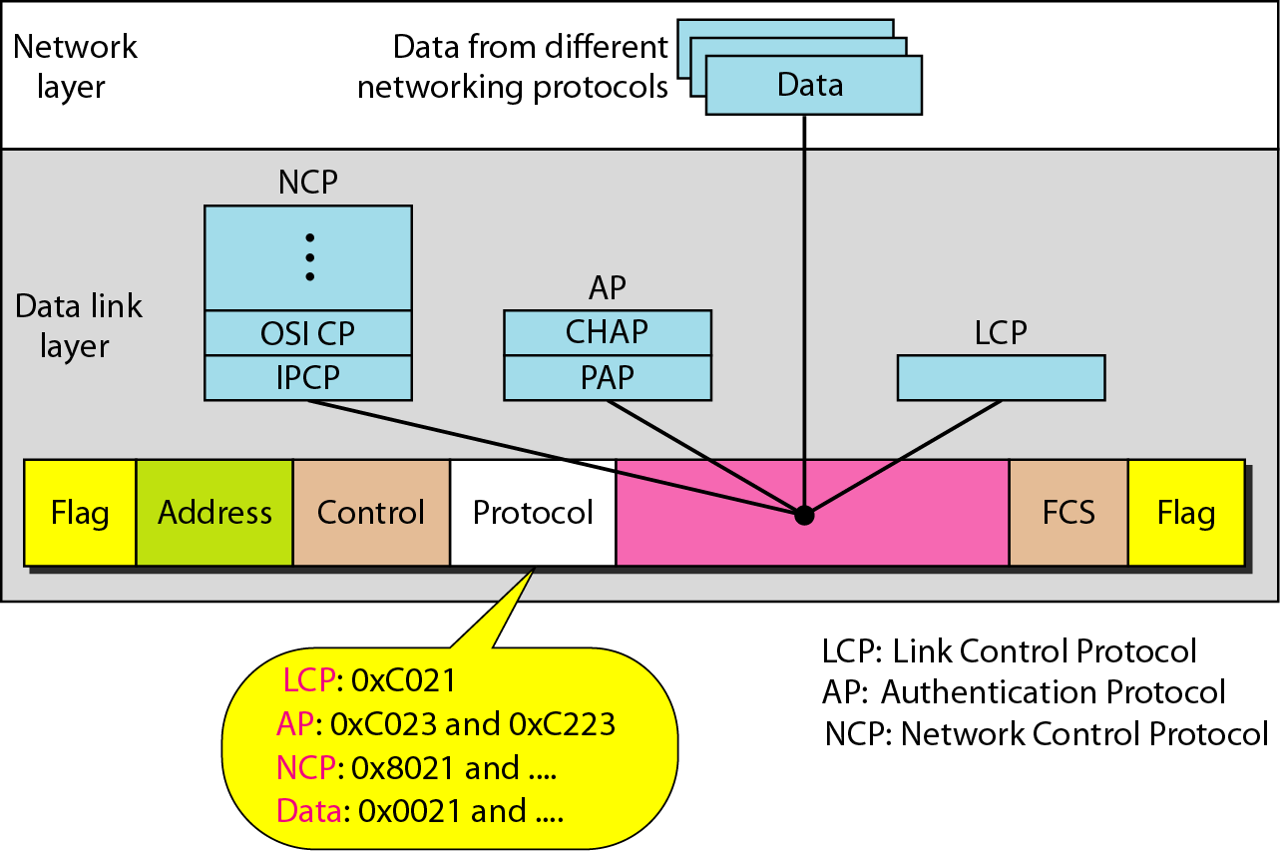
Multiplexing in PPP ...

Slide 66
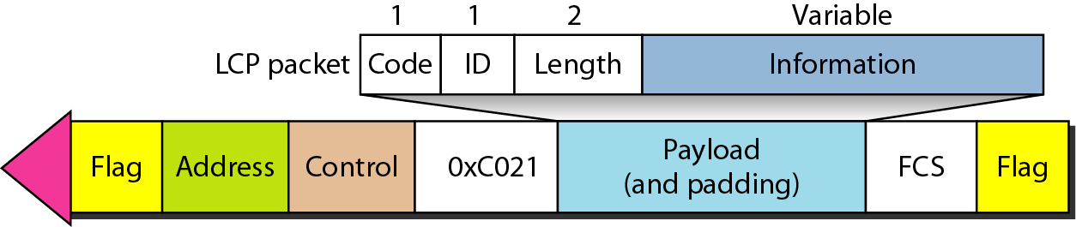
Multiplexing in PPP : LCP
Responsible for establishing, maintaining, configuring, and terminating links
Provides negotiation mechanisms to set options between the two endpoints to reach an agreement about the options before the link can be established
All LCP packets are carried in the payload field of the PPP frame with the protocol field set to C021 in hexadecimal

Slide 67
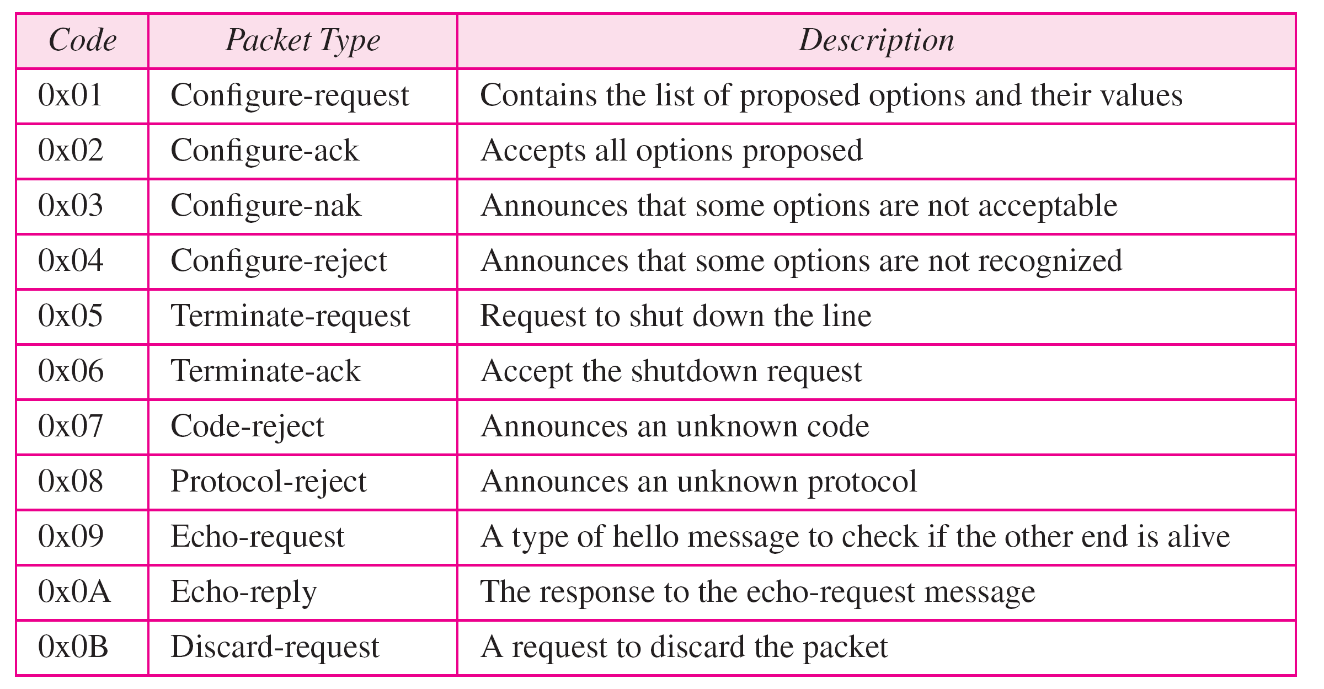
Multiplexing in PPP : LCP ...
The code field defines the type of LCP packet → 11 types of packets
used for link configuration during the establish phase
used for link termination during the termination phase
used for link monitoring and debugging
Notes:
There are three categories of packets.
The first category, comprising the first four packet types, is used for link configuration during the establish phase.
The second category, comprising packet types 5 and 6, is used for link termination during the termination phase
The last five packets are used for link monitoring and debugging.

Slide 68
Multiplexing in PPP : LCP ...
The ID field holds a value that matches a request with a reply
One endpoint inserts a value in this field, which will be copied into the reply packet
The length field defines the length of the entire LCP packet
The information field contains information, such as options, needed for some LCP packets
There are many options that can be negotiated between the two endpoints
Options are inserted in the information field of the configuration packets
Information field is divided into three fields: option type, option length, and option data

Slide 69
Multiplexing in PPP : LCP ...
Common options

Slide 70
Multiplexing in PPP : AP
Authentication plays a very important role in PPP because PPP is designed for use over dial-up links where verification of user identity is necessary
Authentication means validating the identity of a user who needs to access a set of resources
PPP has created two protocols for authentication used during the authentication phase:
Password Authentication Protocol
Challenge Handshake Authentication Protocol

Slide 71
Multiplexing in PPP : AP...
Password Authentication Protocol (PAP) is a simple two-step authentication procedure
a. The user who wants to access a system sends an authentication identification (usually the user name) and a password.
b. The system checks the validity of the identification and password and either accepts or denies connection.
Three types of packets used by PAP
authenticate-request - used by the user to send the user name and password
authenticate-ack - used by the system to allow access
authenticate-nak - used by the system to deny access
When a PPP frame is carrying any PAP packets, the value of the protocol field is 0xC023

Slide 72
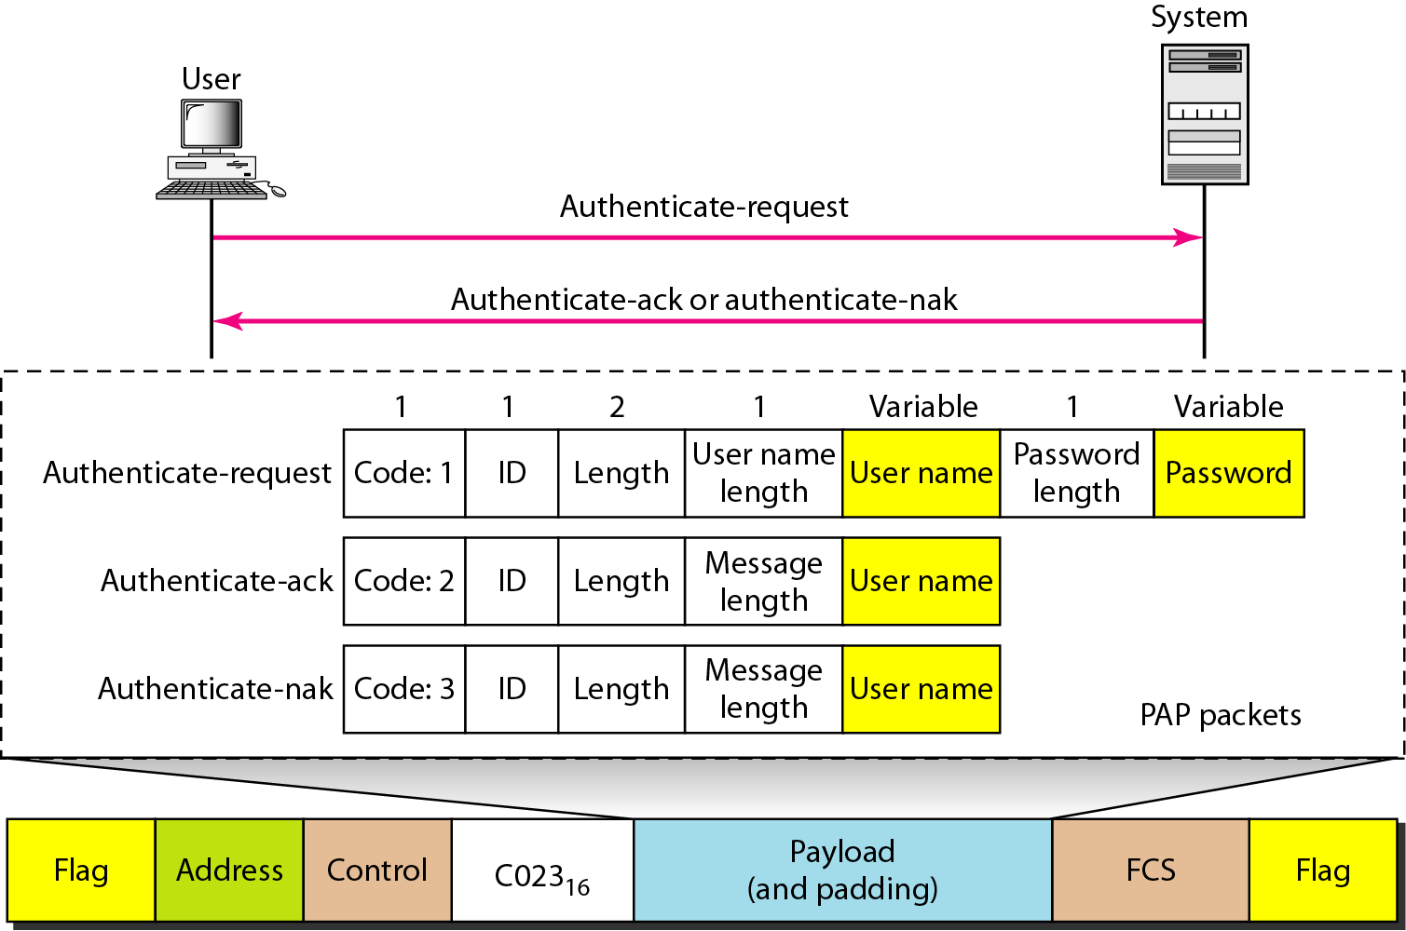
Multiplexing in PPP : AP...
PAP packets encapsulated in a PPP frame

Slide 73
Multiplexing in PPP : AP...
Challenge Handshake Authentication Protocol (CHAP) is a three-way handshaking authentication protocol
Password is kept secret; it is never sent online.
a. The system sends the user a challenge packet containing a challenge value, usually a few bytes
b. The user applies a predefined function that takes the challenge value and the user’s own password and creates a result that is send as response packet to the system
c. The system also applies the same function to the password of the user (known to the system) and the challenge value to create a result
If the result created is the same as the result sent in the response packet, access is granted; otherwise, it is denied
CHAP is more secure than PAP, especially if the system continuously changes the challenge value
Even if the intruder learns the challenge value and the result, the password is still secret

Slide 74
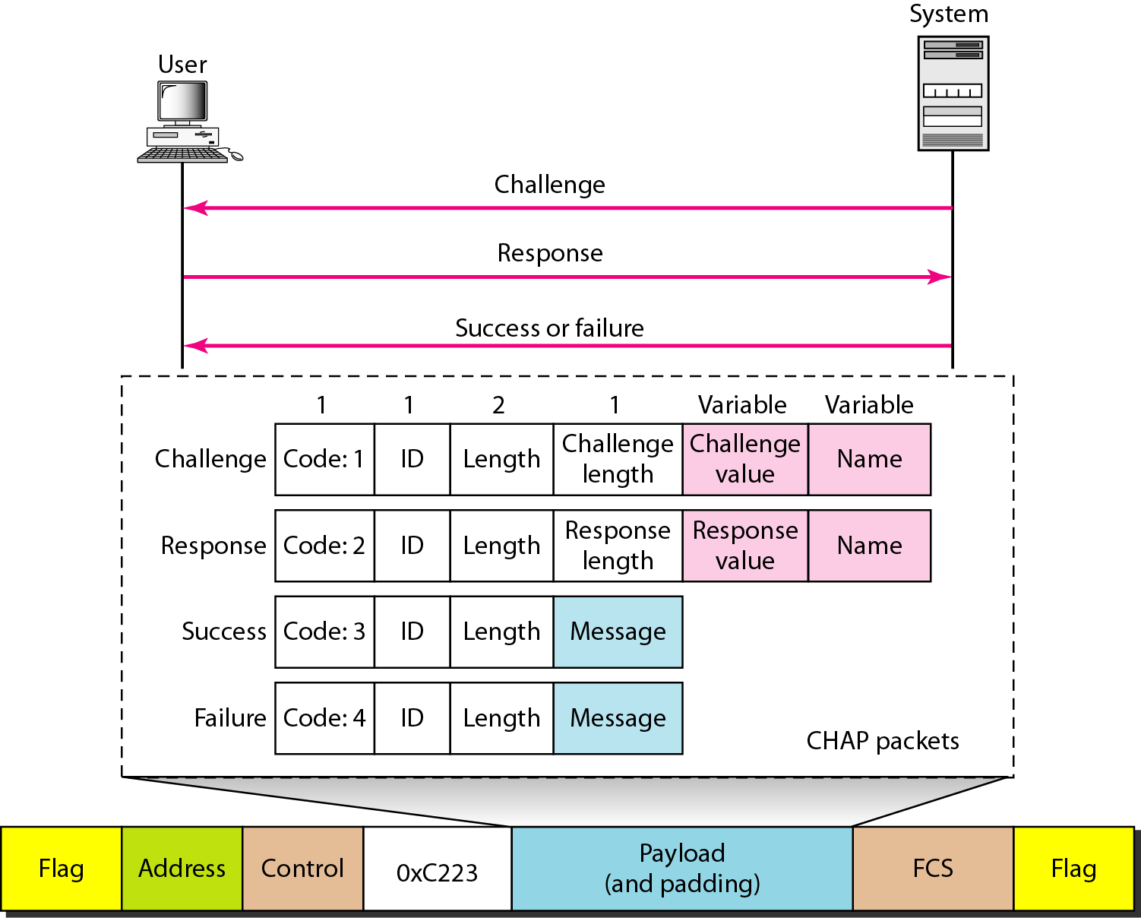
Multiplexing in PPP : AP...
CHAP packets encapsulated in a PPP frame

Slide 75
Multiplexing in PPP : AP...
CHAP packets are encapsulated in the PPP frame with the protocol value C223 in hexadecimal
There are four CHAP packets:
Challenge - used by the system to send the challenge value
Response - used by the user to return the result of the calculation
Success - used by the system to allow access to the system
Failure - used by the system to deny access to the system

Slide 76
Multiplexing in PPP : NCPs
PPP is a multiple-network-layer protocol
PPP has defined a specific Network Control Protocol for each network protocol defined by the Internet, OSI, Xerox, DECnet, AppleTalk, Novel, and so on
For example, IPCP (Internet Protocol Control Protocol) configures the link for carrying IP data packets
Xerox CP does the same for the Xerox protocol data packets
None of the NCP packets carry network-layer data - just configure the link at the network layer for the incoming data

Slide 77
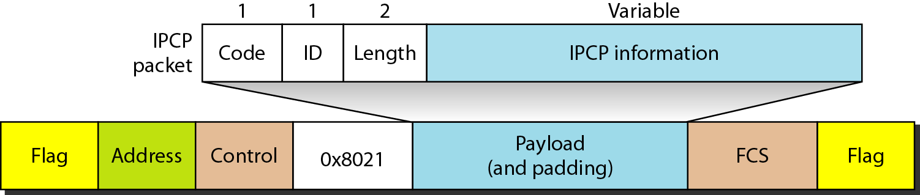
Multiplexing in PPP : NCPs
Internet Protocol Control Protocol (IPCP) configures the link used to carry IP packets in the Internet
Value of the protocol field in the format of an IPCP packet is hexadecimal is 8021
The OSI Network Layer Control Protocol has a protocol field value of 8023
The Xerox NS IDP Control Protocol has a protocol field value of 8025; and so on.

Slide 78
Multiplexing in PPP : NCPs
IPCP defines seven packets, distinguished by their code values

Slide 79
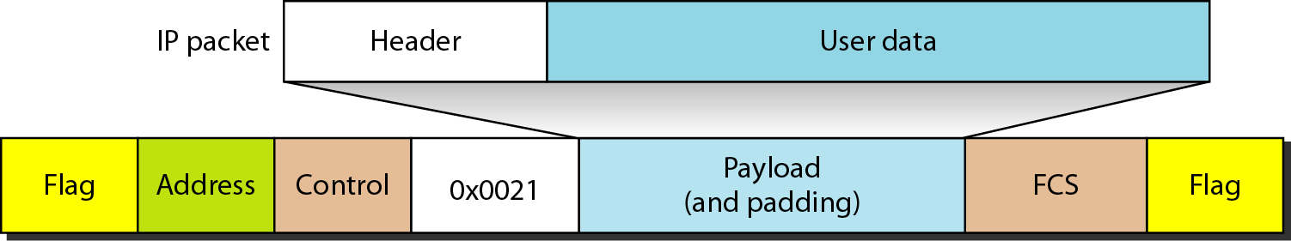
Multiplexing in PPP : NCPs
After the network-layer configuration is completed by one of the NCP protocols, the users can exchange data packets from the network layer
Different protocol fields for different network layers
For example, if PPP is carrying data from the IP network layer, the field value is 0021 (note that the three rightmost digits are the same as for IPCP)
If PPP is carrying data from the OSI network layer, the value of the protocol field is 0023
IP datagram encapsulated in a PPP frame

Slide 80
Multilink PPP
The availability of multiple channels in a single point-to-point link motivated the development of Multilink PPP
A logical PPP frame is divided into several actual PPP frames
A segment of the logical frame is carried in the payload of an actual PPP frame
To show that the actual PPP frame is carrying a fragment of a logical PPP frame, the protocol field is set to (003d)₁₆
This new development adds complexity
For example, a sequence number needs to be added to the actual PPP frame to show a fragment’s position in the logical frame

Slide 81
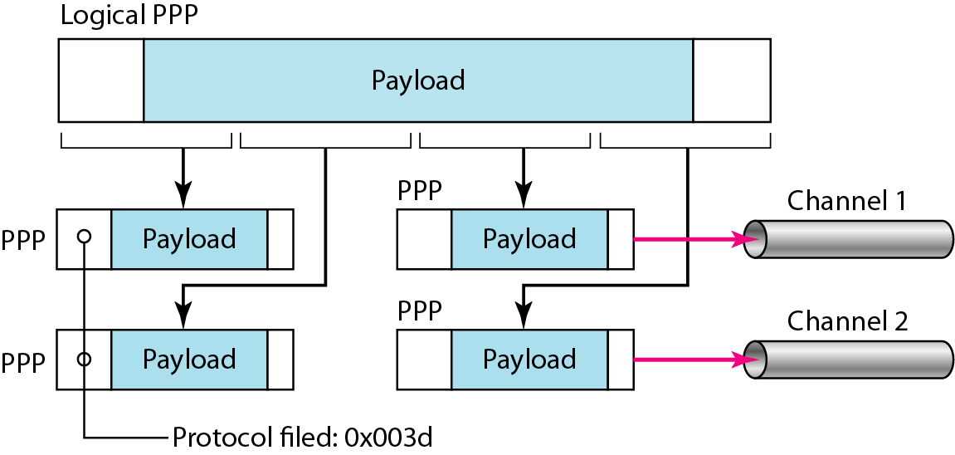
Multilink PPP

Slide 82
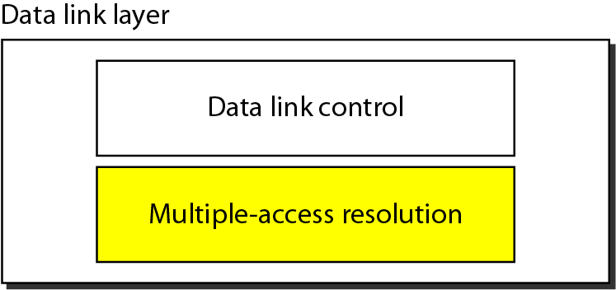
Data link layer - sublayers
Data link layer divided into two functionality-oriented sublayers
Responsible for framing , error and flow control
Responsible framing and MAC address and Multiple Access Control
Coordinate access to the shared link (called as multipoint or broadcast link) between nodes
Broadcast link used in LAN consists of multiple sending and receiving nodes connected to or use a single shared link

Slide 83
Multiple Access Control (MAC)
Problem: When two or more nodes transmit at the same time, their frames will collide and the link bandwidth is wasted during collision
how to determine who gets to use the channel when there is competition for it ?
How to coordinate the access of multiple sending/receiving nodes to the shared link???
Solution: We need a protocol to coordinate the transmission of the active nodes
These protocols are called Medium or Multiple Access Control (MAC) Protocols belong to a sublayer of the data link layer called MAC (Medium Access Control)
What is expected from Multiple Access Protocols:
Main task is to minimize collisions in order to utilize the bandwidth by:
Determining when a station can use the link (medium)
what a station should do when the link is busy
what the station should do when it is involved in collision

Slide 84
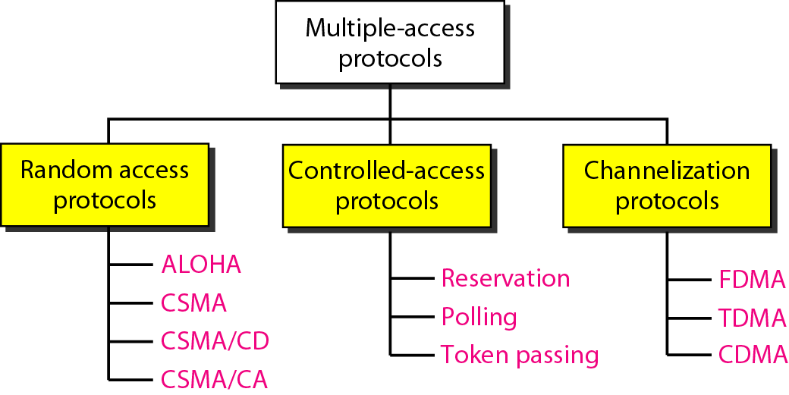
Taxonomy of multiple-access protocols
For wireless

Slide 85
Random Access
Random Access (or contention) Protocols:
No station is superior to another station and none is assigned the control over another
A station with a frame to be transmitted can use the link directly based on a procedure defined by the protocol to make a decision on whether or not to send.
Two features
No scheduled time for a station to transmit - Random Transmission
No rules specify which station should send next
Stations compete with one another to access the medium - contention methods

Slide 86
Evolution of random-access methods
ALOHA -used a very simple procedure called multiple access (MA)
Pure ALOHA - each station sends a frame whenever it has a frame to send
Slotted ALOHA - divide the time into slots and force the station to send only at the beginning of the time slot
Carrier sense multiple access (CSMA) - improved ALOHA
forces the station to sense the medium before transmitting
Two parallel evolved methods
carrier sense multiple access with collision detection (CSMA/CD)
tells the station what to do when a collision is detected
carrier sense multiple access with collision avoidance (CSMA/CA)
tries to avoid the collision

Slide 87
Carrier sense multiple access (CSMA)
Minimize the chance of collision cannot eliminate it
increase the performance
How to minimize chance of collision?
A station should sense the medium before trying to use it (space and time model )
Each station first listen to the medium (or check the state of the medium) before sending
Principle “sense before transmit” or “listen before talk”

Slide 88
CSMA - space and time model
Stations are connected to a shared channel
The possibility of collision still exists because of propagation delay
when a station sends a frame, it still takes time (although very short) for the first bit to reach every station and for every station to sense it
a station may sense the medium and find it idle, only because the first bit sent by another station has not yet been received

Slide 89
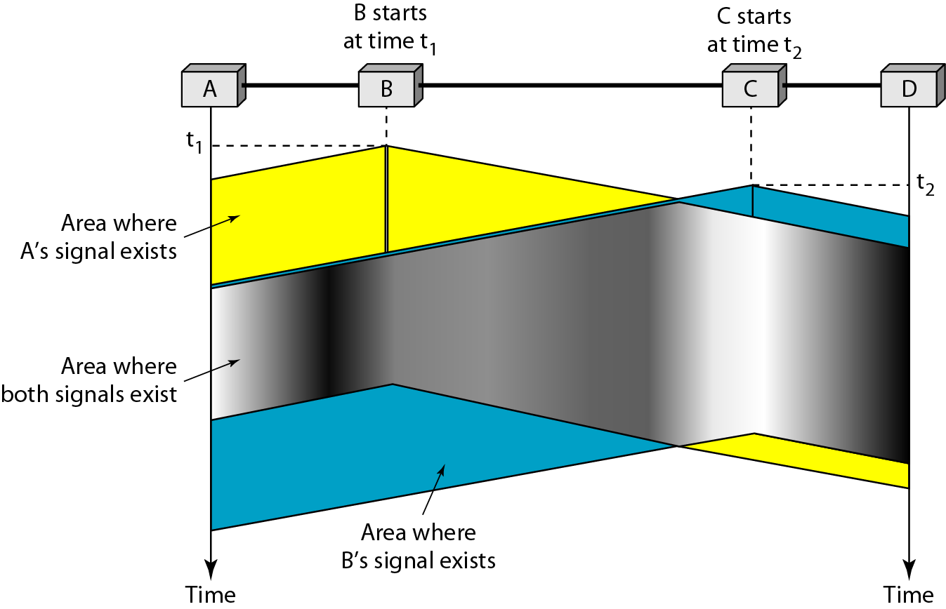
CSMA - space and time model
station B senses the medium and finds it idle, so it sends a frame
station C senses the medium and finds it idle as the first bits from station B have not reached station C, so it sends a frame
two signals collide and both frames are destroyed
Notes:
At time t1, station B senses the medium and finds it idle, so it sends a frame. At
time t2 (t2 > t1), station C senses the medium and finds it idle because, at this time, the
first bits from station B have not reached station C. Station C also sends a frame. The
two signals collide and both frames are destroyed.

Slide 90
CSMA - vulnerable time
Vulnerable time = propagation time T_{p}
T_{p} is time needed for a signal to propagate from one end of the medium to the other
When a station sends a frame and any other station tries to send a frame during this time, a collision will result
If the first bit of the frame reaches the end of the medium, every station will already have heard the bit and will refrain from sending

Slide 91
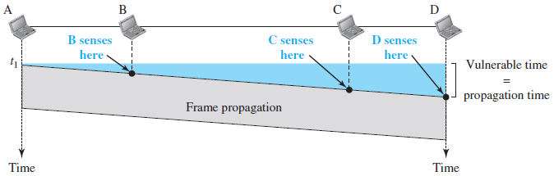
CSMA - vulnerable time
leftmost station, A, sends a frame at time t1, which reaches the rightmost station, D, at time t1 + T_{p}
The gray area shows the vulnerable area in time and space.

Slide 92
CSMA - Persistence Methods
What should a station do if the channel is busy?
What should a station do if the channel is idle?
Three methods have been devised to answer these questions:
1-persistent method
nonpersistent method
p-persistent method

Slide 93
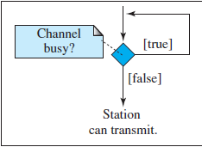
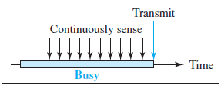
CSMA - 1-Persistent
Simple and straightforward
After the station finds the line idle, it sends its frame immediately (with probability 1)
highest chance of collision because two or more stations may find the line idle and send their frames immediately
Figure shows behavior when a station finds a channel busy

Slide 94
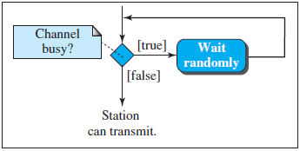

CSMA - Nonpersistent
If a station that has a frame to send senses the line and the line is idle, it sends immediately
If the line is not idle, it waits a random amount of time and then senses the line again
Reduced the chance of collision because it is unlikely that two or more stations will wait the same amount of time and retry to send simultaneously
Reduces the efficiency of the network because the medium remains idle when there may be stations with frames to send

Slide 95
CSMA - p-Persistent
Used if the channel has time slots with a slot duration equal to or greater than the maximum propagation time
Combines the advantages of 1-persistent method and nonpersistent method
Reduces the chance of collision and improves efficiency
After the station finds the line idle it follows these steps:
1. With probability p, the station sends its frame
2. With probability q = 1 − p, the station waits for the beginning of the next time slot and checks the line again
a. If the line is idle, it goes to step 1.
b. If the line is busy, it acts as though a collision has occurred and uses the backoff procedure

Slide 96
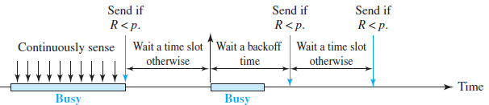
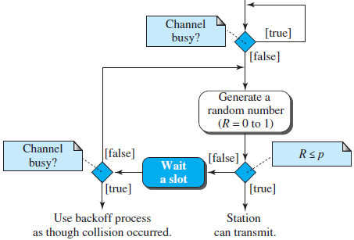
CSMA - p-Persistent

Slide 97
Carrier sense multiple access with collision detection (CSMA/CD)
The CSMA method does not specify the procedure following a collision
CSMA/CD augments the algorithm to handle the collision
A station monitors the medium after it sends a frame to see if the transmission was successful
If so, the station is finished
If there is a collision, the frame is sent again

Slide 98
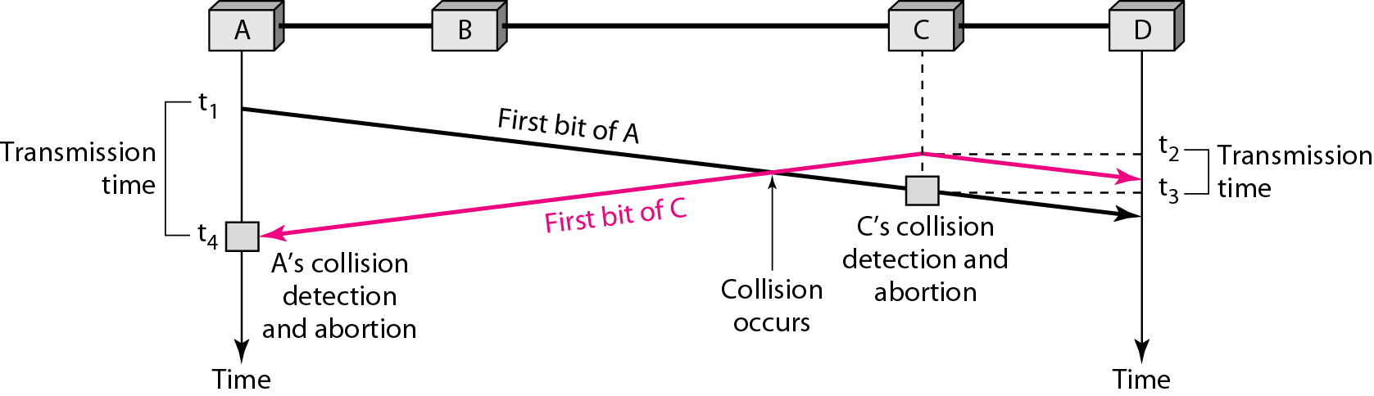
CSMA/CD ...
Look at the first bits transmitted by the two stations involved in the collision
each station continues to send bits in the frame until it detects the collision

Slide 99
CSMA/CD ...
At time t1, station A has executed its persistence procedure and starts sending the bits of its frame
At time t2, station C has not yet sensed the first bit sent by A
Station C executes its persistence procedure and starts sending the bits in its frame, which propagate both to the left and to the right
The collision occurs sometime after time t2
Station C detects a collision at time t3 when it receives the first bit of A’s frame
Station C immediately (or after a short time, but we assume immediately) aborts transmission
Station A detects collision at time t4 when it receives the first bit of C’s frame - immediately aborts transmission
A transmits for the duration t4 − t1; C transmits for the duration t3 − t2

Slide 100
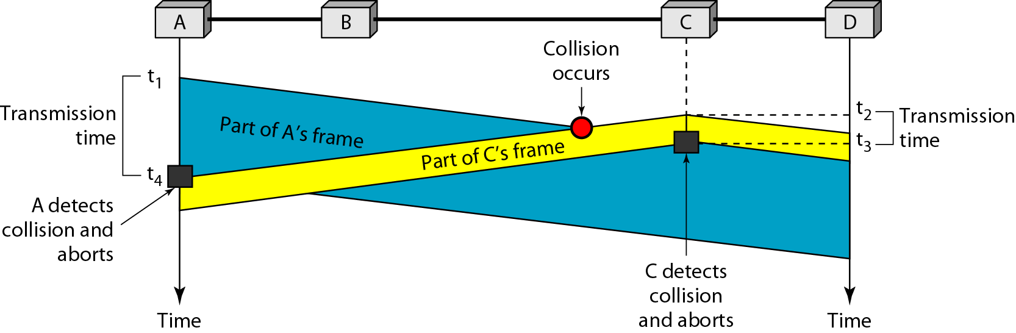
CSMA/CD - Collision and abortion

Slide 101
CSMA/CD -Minimum Frame Size
Need a restriction on the frame size
Before sending the last bit of the frame, the sending station must detect a collision, if any, and abort the transmission
because the station, once the entire frame is sent, does not keep a copy of the frame and does not monitor the line for collision detection
The frame transmission time T_{fr} must be at least two times the maximum propagation time Tp
Worst-case scenario. If the two stations involved in a collision are the maximum distance apart, the signal from the first takes time Tp to reach the second, and the effect of the collision takes another time TP to reach the first
So the requirement is that the first station must still be transmitting after 2Tp

Slide 102
CSMA/CD Example
A network using CSMA/CD has a bandwidth of 10 Mbps
If the maximum propagation time (including the delays in the devices and ignoring the time needed to send a jamming signal is 25.6 μs, what is the minimum size of the frame?
Solution
The minimum frame transmission time is T_{fr} = 2 × Tp = 51.2 μs
The worst case, a station needs to transmit for a period of 51.2 μs to detect the collision
The minimum size of the frame is 10 Mbps × 51.2 μs = 512 bits or 64 bytes
This is actually the minimum size of the frame for Standard Ethernet

Slide 103
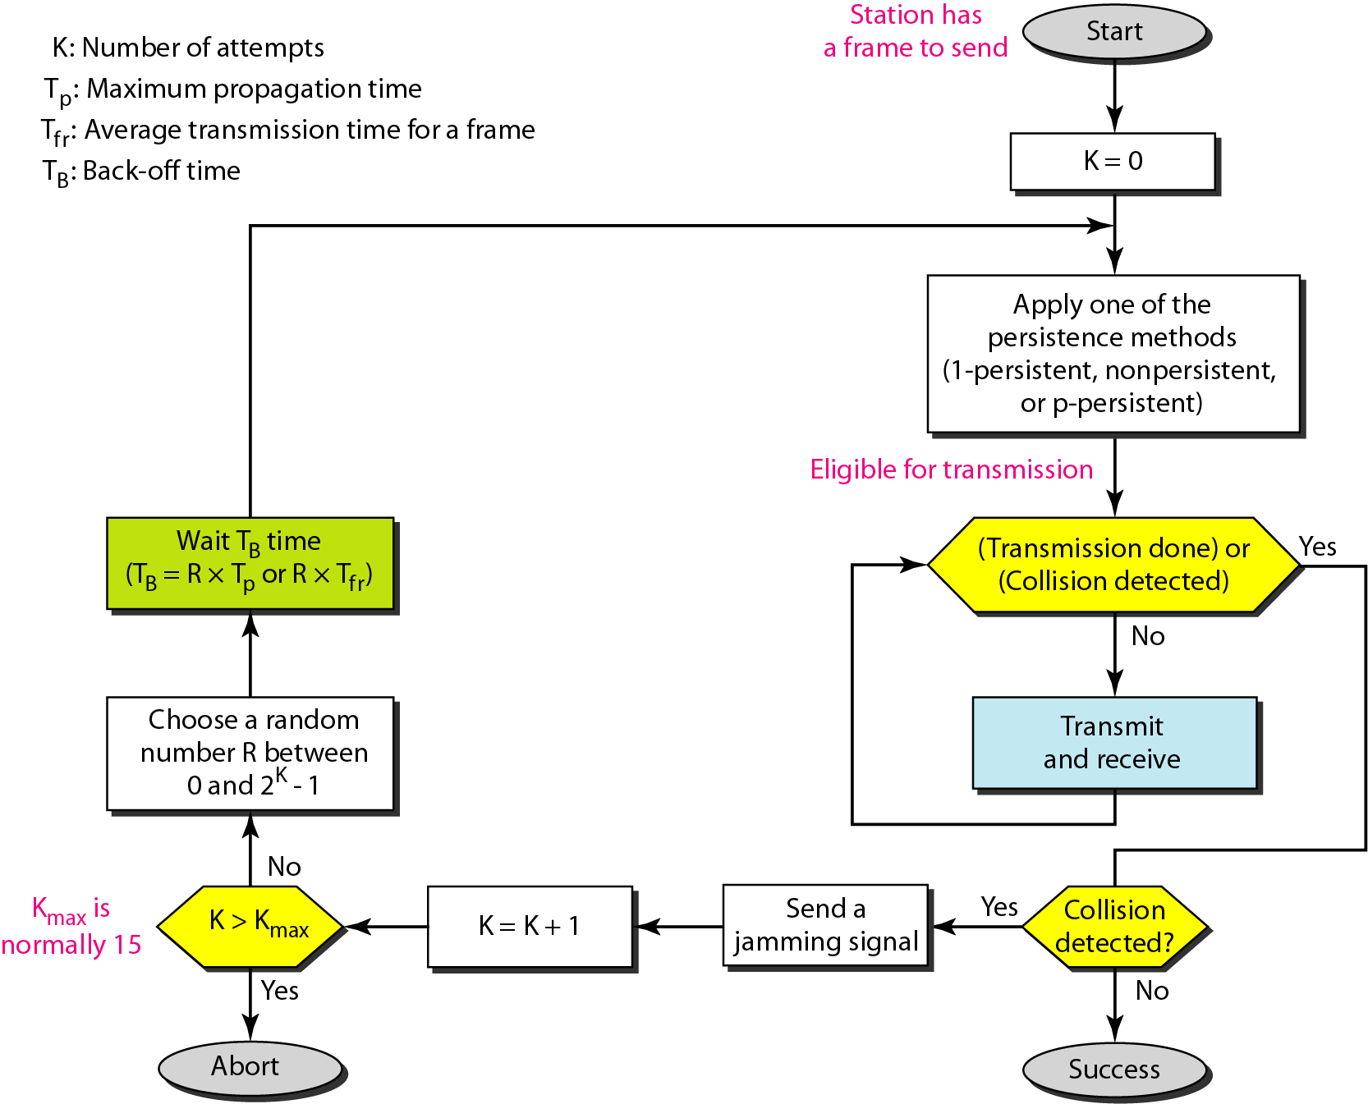
Flow diagram for CSMA/CD

Slide 104
Flow diagram for CSMA/CD
Similar to the one for the ALOHA protocol with 3-differences
addition of the persistence process - sense the channel before start sending the frame by using one of the persistence processes (nonpersistent, 1-persistent, or p-persistent)
frame transmission
In ALOHA, first transmit the entire frame and then wait for an acknowledgment
In CSMA/CD, transmission and collision detection are continuous processes ( shown as a loop)
constantly monitor in order to detect one of two conditions to stop transmission
either transmission is finished or
a collision is detected
On loop exit, if a collision has not been detected, it means that transmission is complete; the entire frame is transmitted. Otherwise, a collision has occurred
Sending of a short jamming signal to make sure that all other stations become aware of the collision

Slide 105
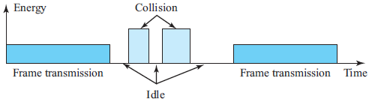
CSMA/CD - Energy Level
The level of energy in a channel can have three values:
Zero - the channel is idle
Normal - station has successfully captured the channel and is sending its frame
Abnormal –there is a collision and the level of the energy is twice the normal level
A station that has a frame to send or is sending a frame needs to monitor the energy level to determine if the channel is idle, busy, or in collision mode

Slide 106
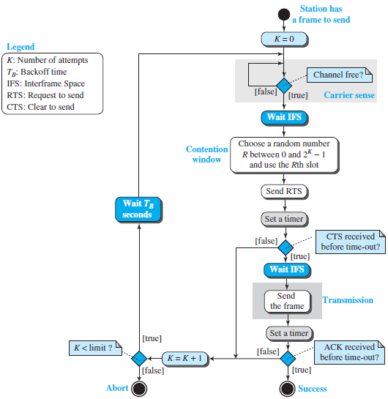
Carrier sense multiple access with collision avoidance - CSMA/CA
Invented for wireless networks
Collisions are avoided through the use of CSMA/CA’s three strategies:
the interframe space
the contention window
acknowledgments

Slide 107
CSMA/CA- Interframe Space (IFS)
Avoids collisions by deferring transmission even if the channel is found idle
When an idle channel is found, the station waits for a period of IFS time
IFS time allows the front of the transmitted signal by the distant station to reach this station
After waiting an IFS time, if the channel is still idle, the station can send, but it still needs to wait a time equal to the contention window
The IFS variable can also be used to prioritize stations or frame types
For example, a station that is assigned a shorter IFS has a higher priority

Slide 108
CSMA/CA - Contention Window
An amount of time divided into slots
A station that is ready to send chooses a random number of slots as its wait time
The number of slots in the window changes according to the binary exponential backoff strategy
It is set to one slot the first time and then doubles each time the station cannot detect an idle channel after the IFS time
Very similar to the p-persistent method except that a random outcome defines the number of slots taken by the waiting station
The station needs to sense the channel after each time slot
However, if the station finds the channel busy, it does not restart the process; it just stops the timer and restarts it when the channel is sensed as idle
This gives priority to the station with the longest waiting time

Slide 109
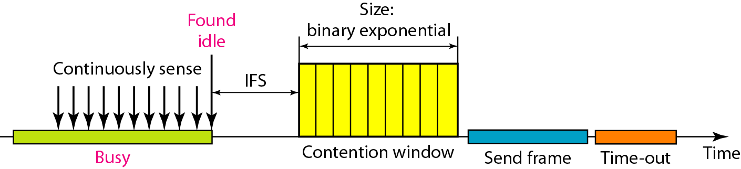
CSMA/CA - Timing

Slide 110
CSMA/CA - Acknowledgment
With all these precautions, there still may be a collision resulting in destroyed data
In addition, the data may be corrupted during the transmission
The positive acknowledgment and the time-out timer can help guarantee that the receiver has received the frame

Slide 111
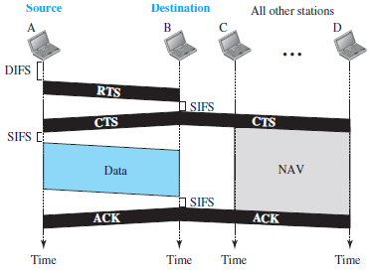
CSMA/CA -Frame Exchange Time Line

Slide 112
CSMA/CA -Frame Exchange Time Line
Exchange of data and control frames in time.
1. Before sending a frame, the source station senses the medium by checking the energy level at the carrier frequency
a. The channel uses a persistence strategy with backoff until the channel is idle
b. After the station is found to be idle, the station waits for a period of time called the DCF interframe space (DIFS); then the station sends a control frame called the request to send (RTS).
2. After receiving the RTS and waiting a period of time called the short interframe space (SIFS), the destination station sends a control frame, called the clear to send (CTS), to the source station. This control frame indicates that the destination station is ready to receive data.
3. The source station sends data after waiting an amount of time equal to SIFS.
4. The destination station, after waiting an amount of time equal to SIFS, sends an acknowledgment to show that the frame has been received. Acknowledgment is needed in this protocol because the station does not have any means to check for the successful arrival of its data at the destination. On the other hand, the lack of collision is a kind of indication to the source that data have arrived.

Slide 113
CSMA/CA - Network Allocation Vector
How do other stations defer sending their data if one station acquires access?
how is the collision avoidance aspect of this protocol accomplished?
Use key feature Network Allocation Vector (NAV):
When a station sends an RTS frame, it includes the duration of time that it needs to occupy the channel
The stations that are affected by this transmission create a timer called a network allocation vector (NAV) that shows how much time must pass before these stations are allowed to check the channel for idleness
Each time a station accesses the system and sends an RTS frame, other stations start their NAV

Slide 114
CSMA/CA -Collision During Handshaking
handshaking period - time when RTS or CTS control frames are in transition
What happens if there is a collision during handshaking period ?
Indicates two or more stations may try to send RTS frames at the same time which may collides
No mechanism for collision detection, the sender assumes there has been a collision if it has not received a CTS frame from the receiver
The backoff strategy is employed, and the sender tries again

Slide 115
CSMA/CA - Hidden-Station Problem
Use of the handshake frames (RTS and CTS)
The RTS message from A reaches B, but not C.
However, because both A and C are within the range of B, the CTS message, which contains the duration of data transmission from B to A, reaches C
Station C knows that some hidden station is using the channel and refrains from transmitting until that duration is over

Slide 116
Controlled access
The stations consult one another to find which station has the right to send
A station cannot send unless it has been authorized by other stations
Three controlled-access methods
Reservation method
Polling
Token Passing

Slide 117
Reservation method
A station needs to make a reservation before sending data
Time is divided into intervals
A reservation frame precedes the data frames sent in each interval.
If there are N stations in the system, there are exactly N reservation mini slots in the reservation frame
Each minislot belongs to a station - When a station needs to send a data frame, it makes a reservation in its own minislot
The stations that have made reservations can send their data frames after the reservation frame

Slide 118
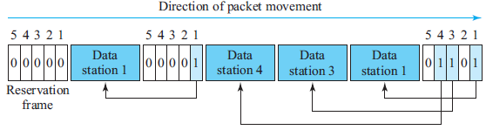
Reservation access method
Five stations and a five-minislot reservation frame
In the first interval, only stations 1, 3, and 4 have made reservations
In the second interval, only station 1 has made a reservation

Slide 119
Polling
Works with topologies in which one device is designated as a primary station that controls the link and the other devices are secondary stations that follow its instructions
All data exchanges must be made through the primary device even when the ultimate destination is a secondary device
Primary device - determine which device is allowed to use the channel at a given time and always the initiator of a session
uses poll and select functions to prevent collisions
Drawback - if the primary station fails, the system goes down

Slide 120
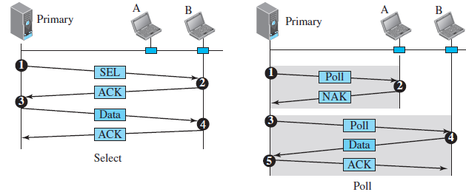
Polling ...
used whenever the primary device has something to send.
Primary does not know whether the target device is prepared to receive
Primary alert the secondary about the upcoming transmission and wait for an acknowledgment of the secondary’s ready status using select (SEL) frame
One field of SEL includes the address of the intended secondary
Used by the primary device to solicit transmissions from the secondary devices
When the primary is ready to receive data, it must ask (poll) each device in turn if it has anything to send
When the first secondary is approached, it responds either with a AK frame if it has nothing to send or with data if it does
If the response is negative (a NAK frame), then the primary polls the next secondary in the same manner until it finds one with data to send
When the response is positive (a data frame), the primary reads the frame and returns an acknowledgment (ACK frame), verifying its receipt

Slide 121
Token Passing
The stations in a network are organized in a logical ring where each station has a predecessor and a successor
The predecessor is the station which is logically before the station in the ring; the successor is the station which is after the station in the ring
The current station is the one that is accessing the channel now
The right to this access has been passed from the predecessor to the current station then to the successor when the current station has no more data to send

Slide 122
Token Passing
how is the right to access the channel passed from one station to another?
A special packet called a token circulates through the ring
The possession of the token gives the station the right to access the channel and send its data
When a station has some data to send, it waits until it receives the token from its predecessor
It then holds the token and sends its data
When the station has no more data to send, it releases the token, passing it to the next logical station in the ring
The station cannot send data until it receives the token again in the next round
When a station receives the token and has no data to send, it just passes the data to the next station

Slide 123
Token management
Stations must be limited
The token must be monitored to ensure it has not been lost or destroyed
For example, if a station that is holding the token fails, the token will disappear from the network
Assign priorities to the stations and to the types of data being transmitted
make low-priority stations release the token to high-priority stations

Slide 124
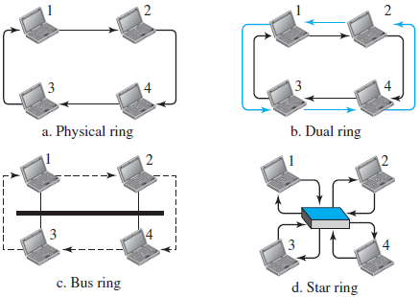
Logical Ring
Four different physical topologies that can create a logical ring

Slide 125
Physical Ring Topology
When a station sends the token to its successor, the token cannot be seen by other stations; the successor is the next one in line
Token does not have to have the address of the next successor
Problem - if one of the links (the medium between two adjacent stations) fails, the whole system fails

Slide 126
Dual Ring Topology
Uses a second (auxiliary) ring which operates in the reverse direction compared with the main ring
The second ring is for emergencies only (such as a spare tire for a car) - If one of the links in the main ring fails, the system automatically combines the two rings to form a temporary ring
After the failed link is restored, the auxiliary ring becomes idle again
Each station needs to have two transmitter ports and two receiver ports
The high-speed Token Ring networks called FDDI (Fiber Distributed Data Interface) and CDDI (Copper Distributed Data Interface) use this topology

Slide 127
Bus Ring Topology – Token Bus
Stations are connected to a single cable called a bus-make a logical ring, because each station knows the address of its successor (and also predecessor for token management purposes)
When a station has finished sending its data, it releases the token and inserts the address of its successor in the token
Only the station with the address matching the destination address of the token gets the token to access the shared media
The Token Bus LAN, standardized by IEEE, uses this topology

Slide 128
Star Ring Topology
Physical topology is a star where a hub acts as the connector
The wiring inside the hub makes the ring; the stations are connected to this ring through the two wire connections
This topology makes the network less prone to failure because if a link goes down, it will be bypassed by the hub and the rest of the stations can operate
Also adding and removing stations from the ring is easier
Still used in the Token Ring LAN designed by IBM

